Slide 1
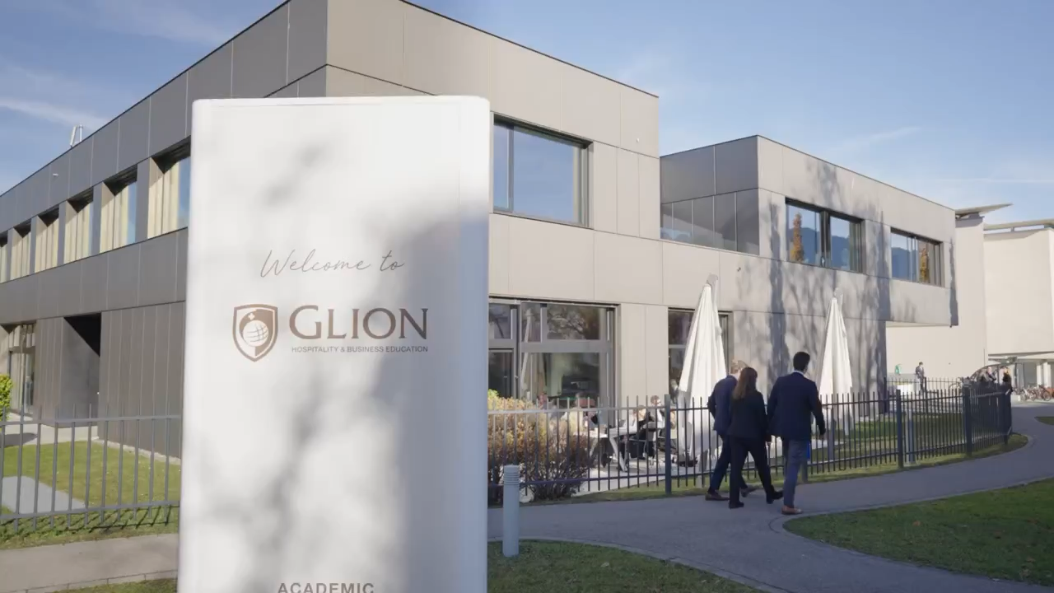

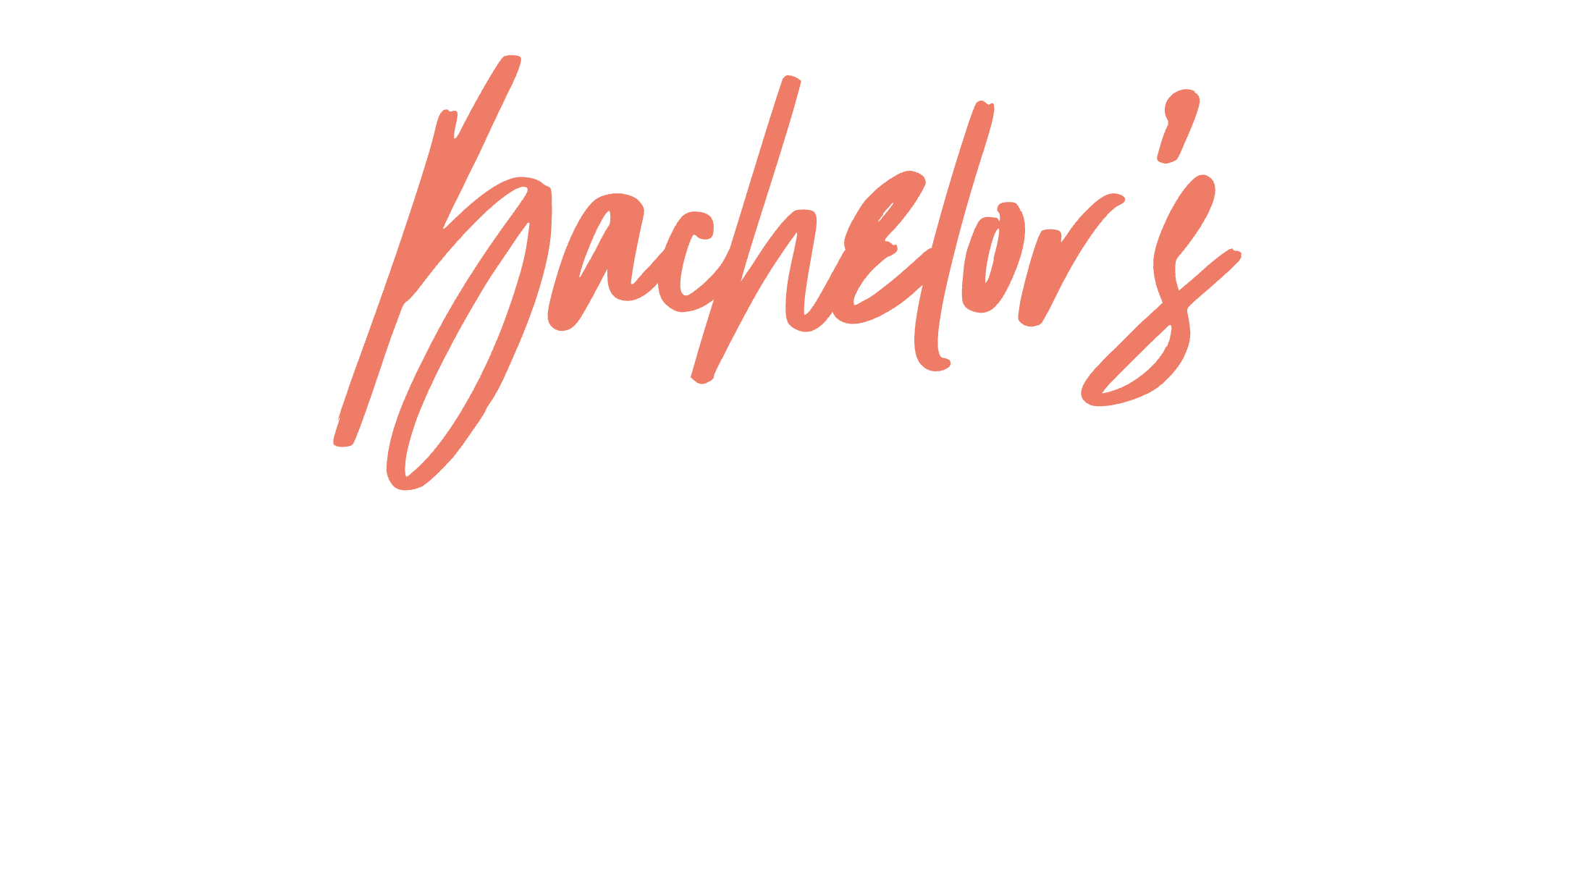
GLION
ACADEMIC PROGRAMS

Slide 2
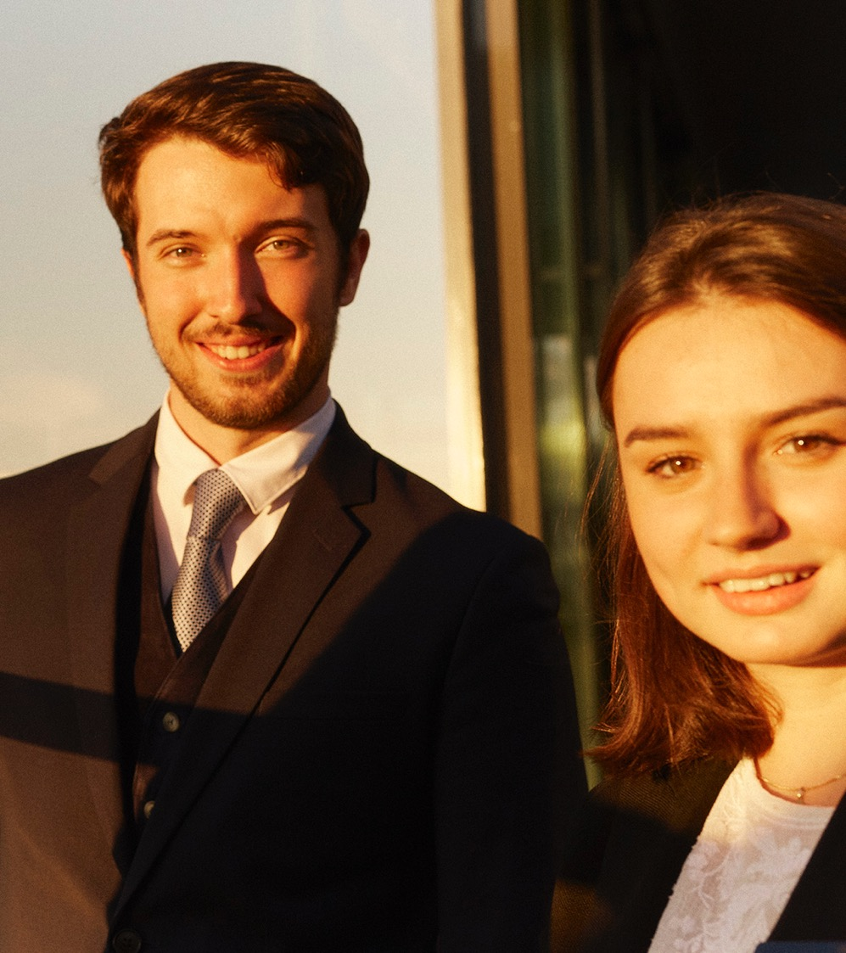

Immersion in luxury
Bachelor’s
in Luxury Business
Management skills
Direct industry exposure
Essential hard & soft skills mix
Opens doors to dream roles
for high school students
Practice in hospitality makes perfect
Bachelor’s
in International Hospitality Business
Real-world experience
Apply business knowledge
International study opportunities
More than a degree, a career maker

Slide 3
Bachelor’s in Luxury Business
Luxury Immersion
Luxury Management
Strategic Leadership
The Future of Luxury
SEMESTER 1
SEMESTER 2
SEMESTER 1
SEMESTER 2
SEMESTER 3
SEMESTER 4
SEMESTER 5
SEMESTER 6
Luxury Fundamentals
Hospitality Professional Immersion
Luxury Management I
Luxury Management II
Management Practice
Strategic Luxury Leadership
Crafting
Tomorrow’s Luxury & Business Project
On-The-Job Experience & Business Project
Glion
Internship
Bulle
Bulle
Internship
Bulle
Bulle
Worldwide
Year 1:
Experiential Year
Year 1:
Bachelor of Science
Year 2:
Bachelor of Science
Year 3:
Bachelor of Science
SEMESTER 1
SEMESTER 2
SEMESTER 1
SEMESTER 2
SEMESTER 3
SEMESTER 4
SEMESTER 5
SEMESTER 6
Hospitality Excellence Practical Arts
Hospitality Professional Immersion
Hospitality Fundamentals
Hospitality Management
Management Practice
Integrated Business Strategies
Specialization &
Business Project
On-The-Job Experience & Business Project
Glion
Internship
Bulle, London or Marbella*
Bulle, London or Marbella*
Internship
Bulle or London
Bulle or London
Worldwide
Hospitality Experiential Year
Hospitality Managerial Excellence
Business Proficiency
Professional Expertise
Bachelor’s in International Hospitality Business
*Opportunity to study this semester on international exchange at another Sommet Education campus (depending on availability).
**Opportunity to study this semester on international exchange at another SE campus depending on availability

Slide 4
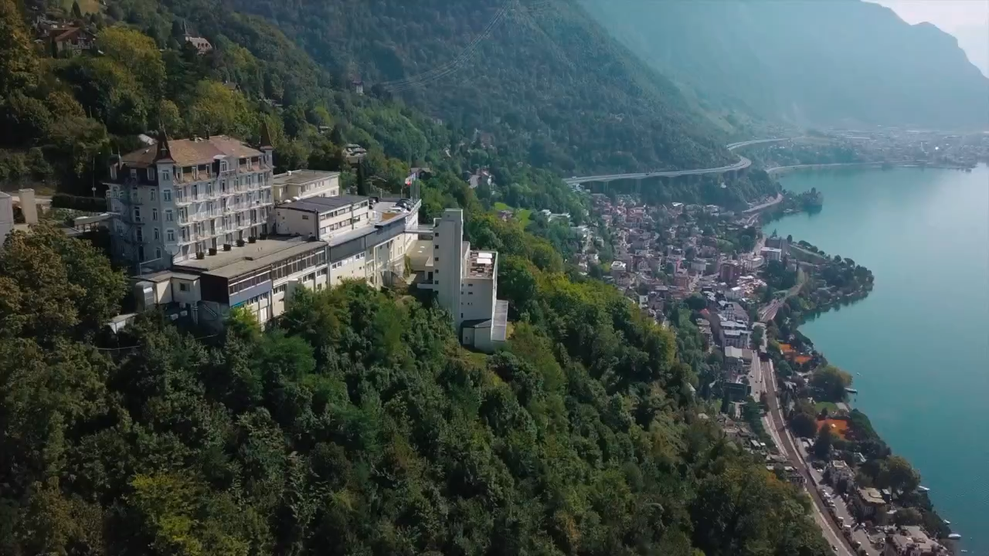


IN INTERNATIONAL HOSPITALITY BUSINESS

Slide 5
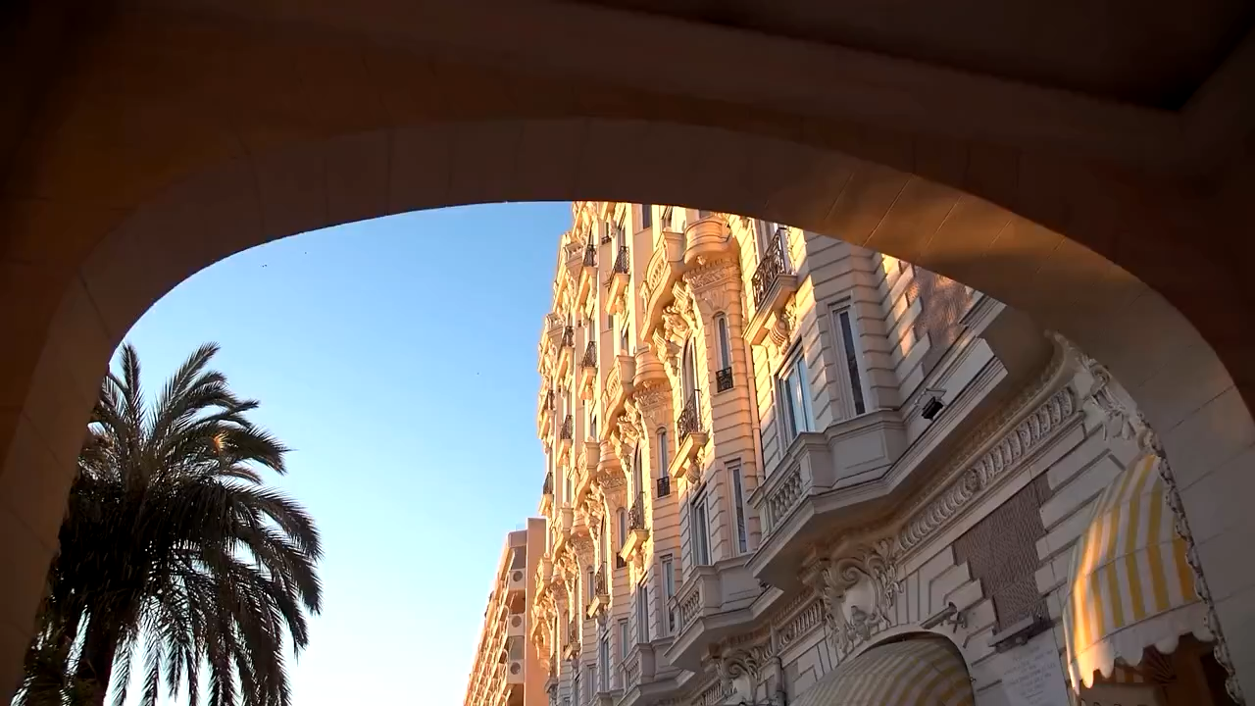

Hospitality is
Hospitality today is…
Hotels
Events
Travel
Restaurants
…AND SO ARE THE OPPORTUNITIES
Tourism
Theme parks

Slide 6
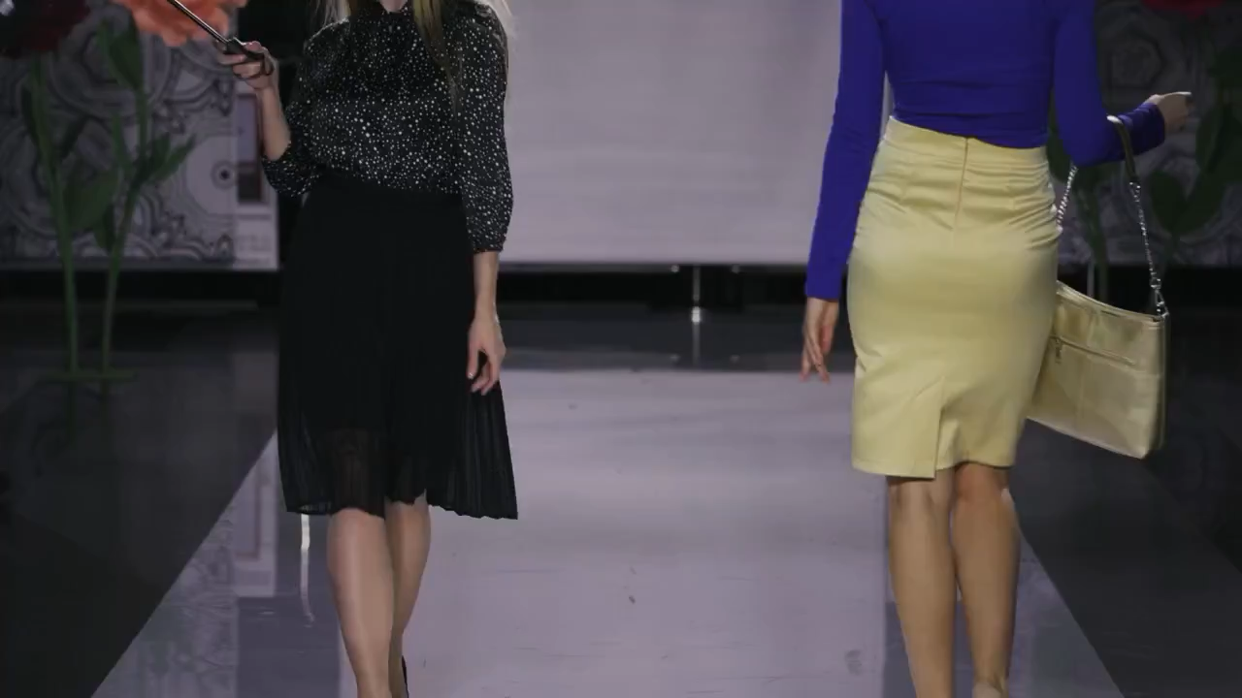
Through the experience industry, it’s expanding…
Hospitality today is…
Hotels
Finance
Hotels
Events
Consumer tech
Events
Travel
International events
Travel
Restaurants
Luxury retail
Restaurants
Tourism
Tourism
Theme parks
Motor sports
Entertainment
Theme parks

Slide 7
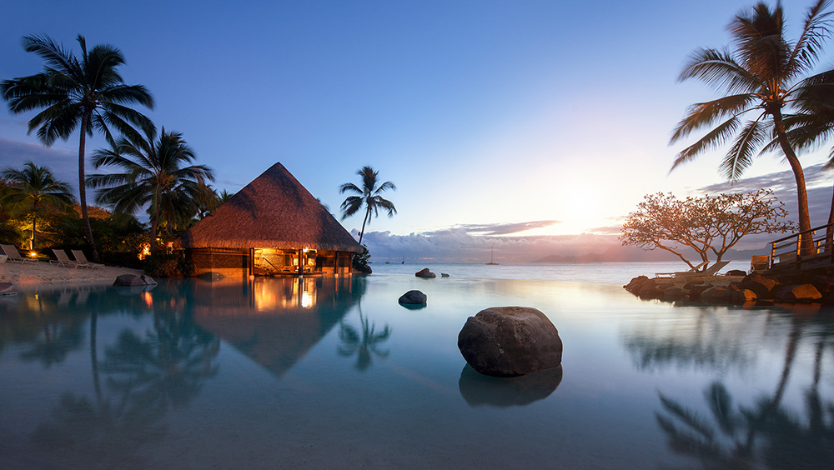





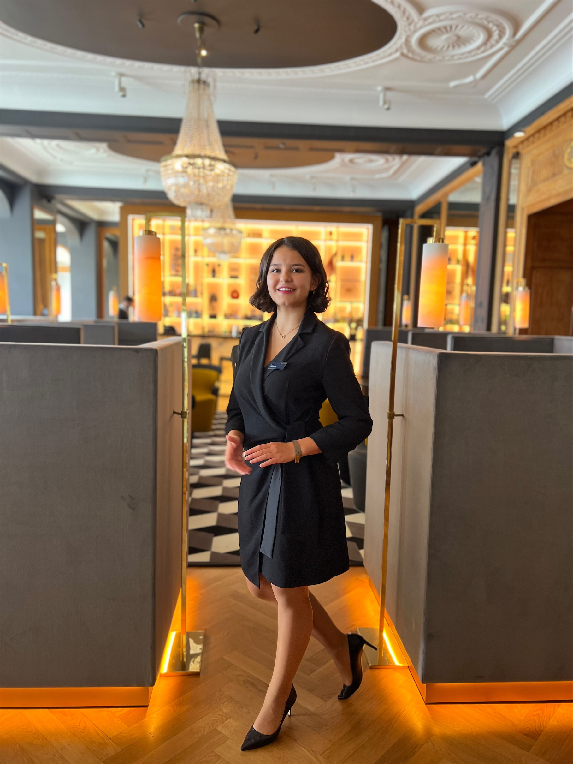
in International Hospitality Business
Bulle, London
or Marbella*
Bulle, London
or Marbella*
Duration
4 years, 8 semesters
Intakes
Spring & Fall
Credits
ECTS* 180 / US 120
Glion campus
Internship
Internship
Bulle or London
Bulle or London
Worldwide
3
6-month internships/
On-the-Job Experience
1
Masterclass in Luxury Gastronomy and Hospitality
1
Business
Field Trip
SEMESTER
1
SEMESTER
2
SEMESTER
3
SEMESTER
4
SEMESTER
5
SEMESTER
6
SEMESTER
7
SEMESTER
8
Hospitality Excellence Practical Arts
Professional Immersion
Hospitality Fundamentals
Hospitality Management
Management Practice
Integrated Business Strategies
Specialization & Thesis or Applied Business Project
On-The-Job Experience & Research Project
1
Research
Project
3 Specializations
Luxury Brand Strategy
International Hotel Development and Finance
Guest Experience and Event Management
Year 1:
Experiential Year
Year 2:
Academic Program
Year 3:
Academic Program
Year 4:
Academic Program
*European Credit Transfer and Accumulation System
*Opportunity to study this semester on international exchange at another SE campus depending on availability
Notes:
Prepare for a global career
This Bachelor’s degree is the perfect preparation for high-level leadership careers not just in the global hospitality industry, but also any customer-facing business where professional behavior and soft skills are prized. The curriculum features applied practical and academic learning, with three professional internships and the opportunity to choose a specialization in the final academic semester.
Year 1: Experiential Year
In your Practical Arts semester, you’ll learn, practice and assimilate the highest standards of hospitality service and operations under the eye of leading culinary and hospitality professionals.
Year 2: Academic Program
After putting your knowledge to the test with real-life customers and colleagues during your first internship, you will start to further build and refine your management skills.
Year 3: Academic Program
Learn how to lead a hospitality business and master the tools of the trade, working through simulated hotel development and revenue management projects with experienced faculty members.
Year 4: Academic Program
Develop your critical thinking, research and writing skills to produce high-quality professional work and complete an applied business project or Bachelor's Thesis

Slide 8


IN LUXURY BUSINESS
Open doors to a career in luxury

Slide 9
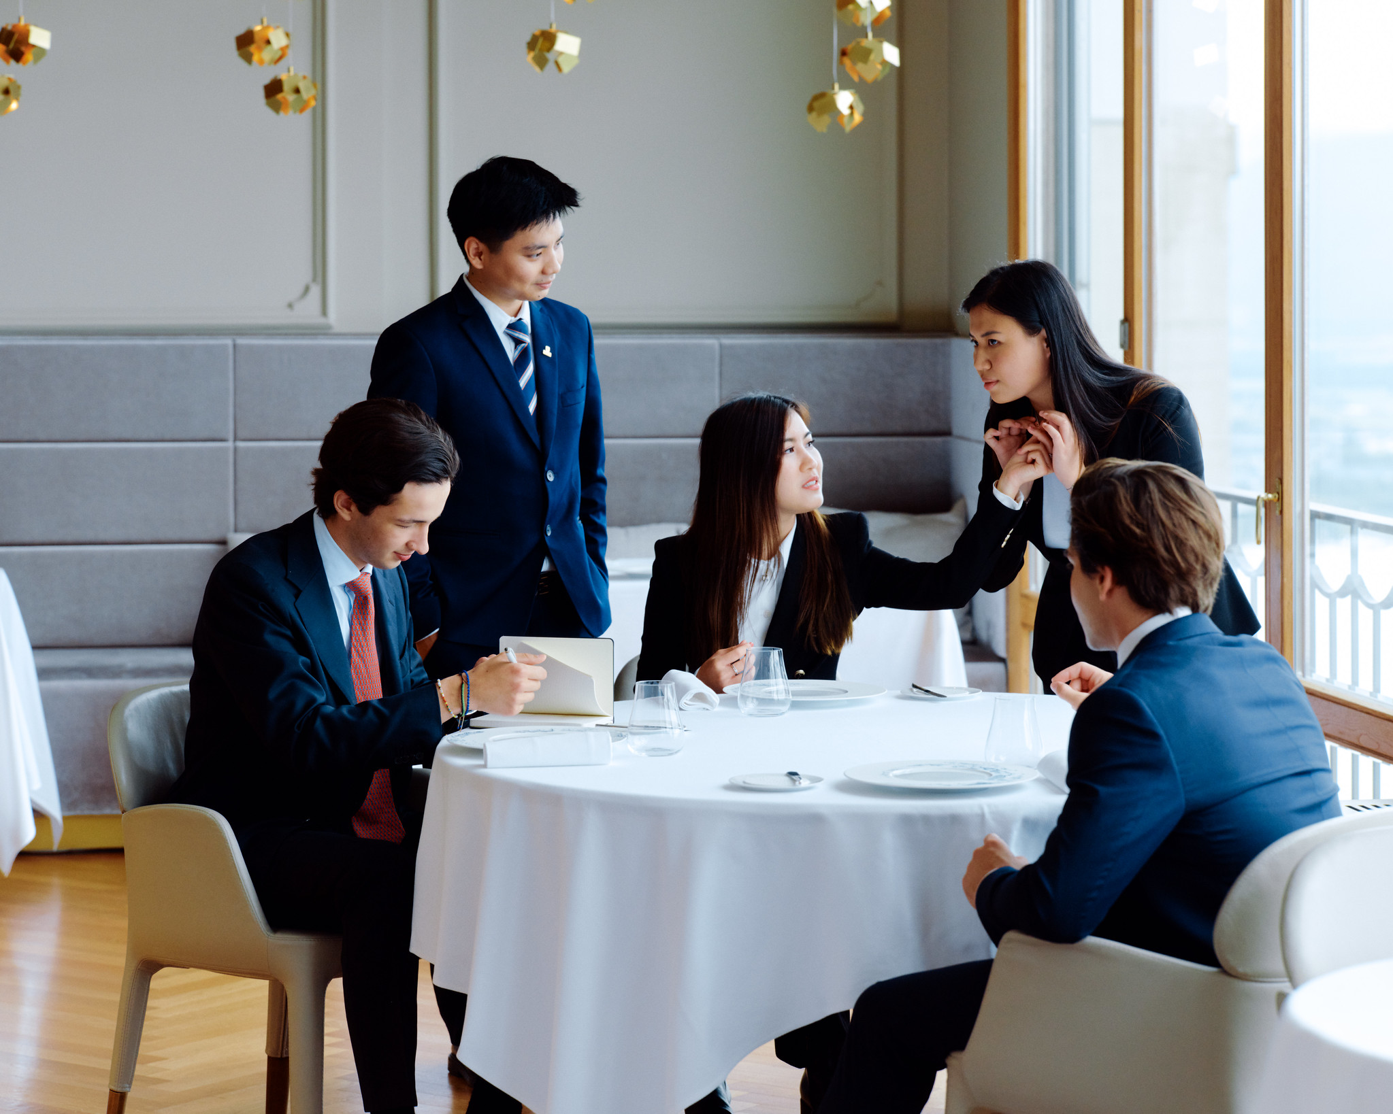






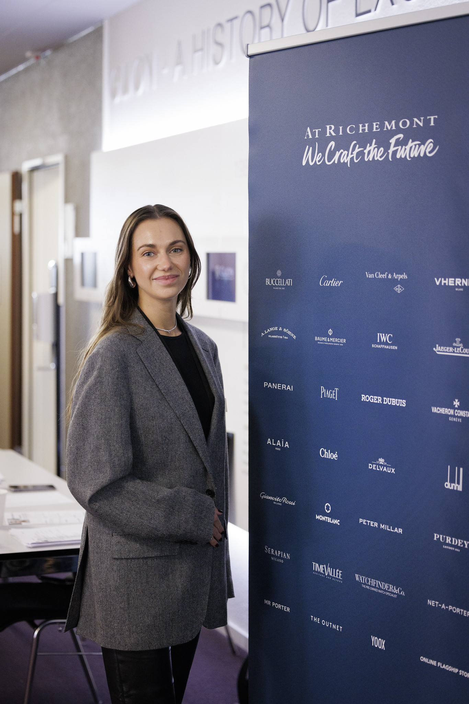








is this program for?
Ambitious, creative and globally-minded students
Aspiring to work with prestigious global brands
BACHELOR’S IN LUXURY BUSINESS
Passionate about luxury brands, fashion, hospitality, real estate and high-end services
Seeking to master luxury customer experience and brand storytelling
Diligent entrepreneurs in the luxury industry
opportunities
Luxury Brand Management
fashion, watches, jewelry, automobiles
Real Estate & Yachting
high-end property development, yacht management
Luxury Retail & Merchandising
flagship stores, personal shopping
Entrepreneurship
launching a luxury brand
or boutique business
Luxury Marketing & PR
digital marketing, event planning, influencer collaborations
Luxury Hospitality & Travel
hotels, private concierge services

Slide 10
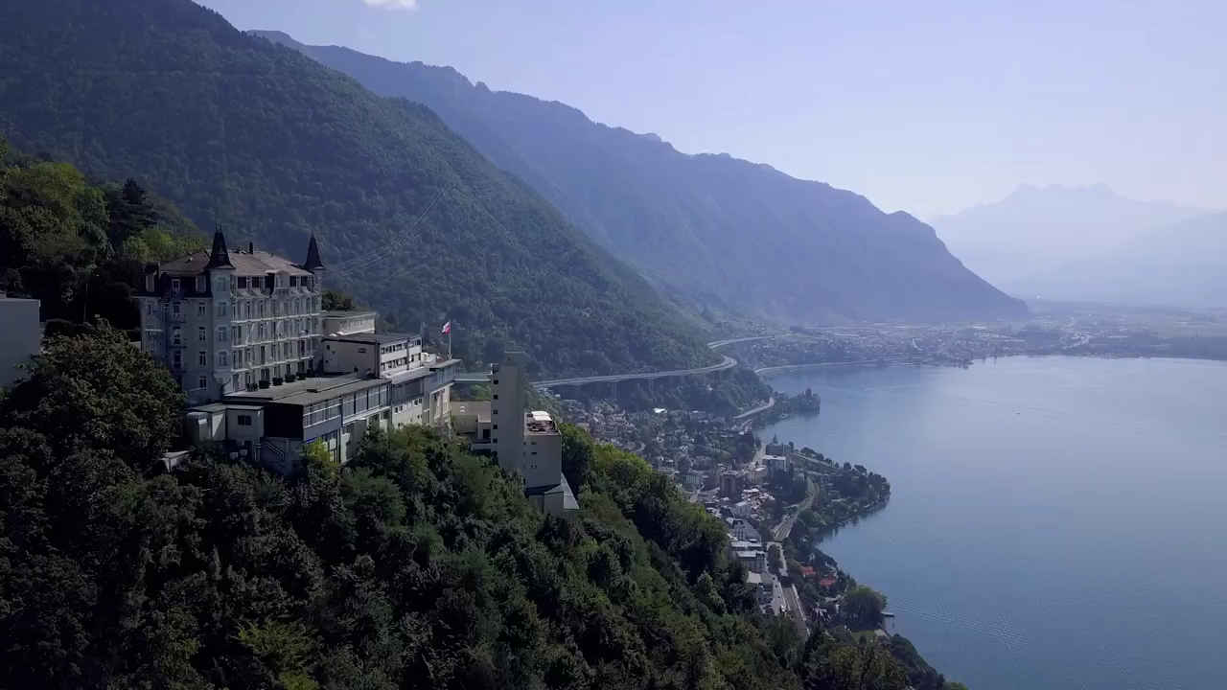

Slide 11












is this program for?
Students passionate about hospitality, tourism, and event management
Those who aspire to work in international business, luxury hospitality, or entrepreneurship
BACHELOR’S IN INTERNATIONAL HOSPITALITY BUSINESS
Individuals seeking a dynamic, customer-centric career
Future leaders who want to develop management, finance, and operational skills
Those eager to experience global internships and industry exposure
opportunities
Hotel & Resort Management
luxury and boutique brands
Luxury Retail & Customer Experience Management
Tourism & Travel Industry
airlines, cruise lines, tour operators
Entrepreneurship
launching hospitality or service-related businesses
Event & Experience Management
corporate events, sports hospitality, luxury weddings
Food & Beverage Management
fine dining, restaurant chains, catering services
Hospitality Real Estate
& Development

Slide 12
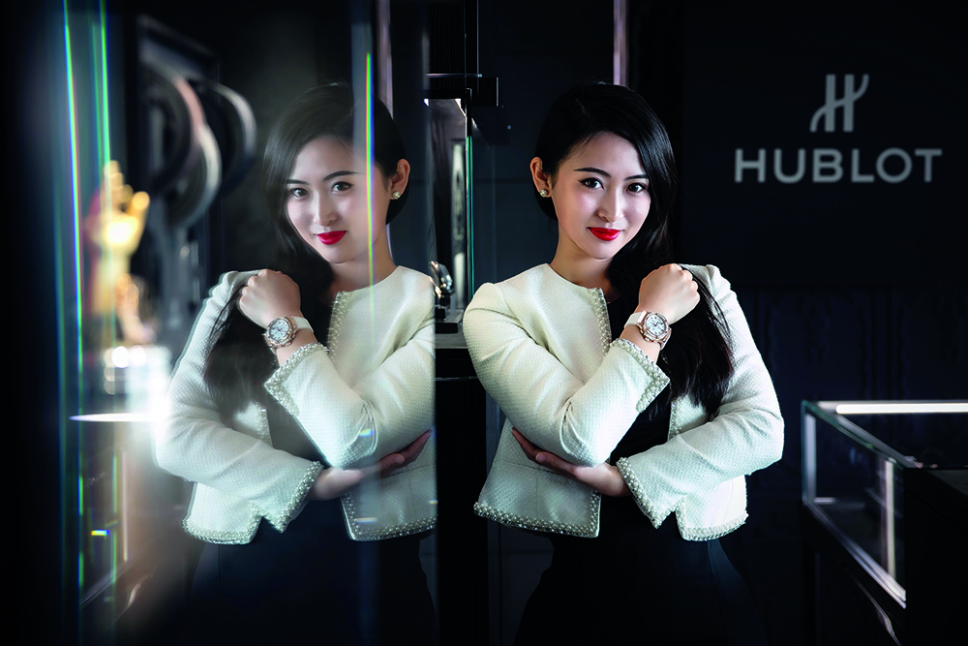
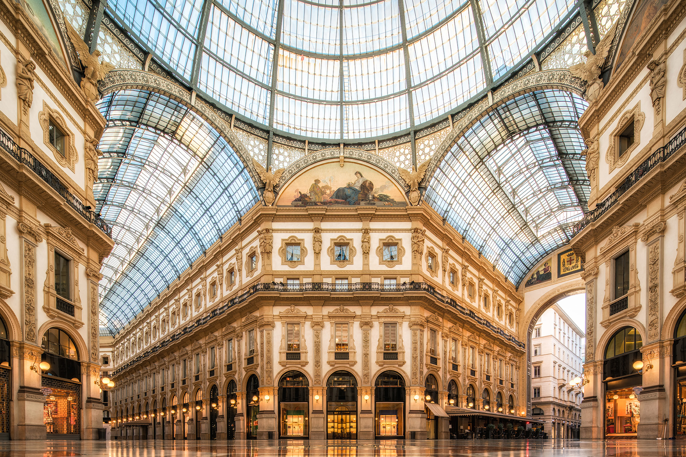
in Luxury Business
Duration
4 years, 8 semesters
Intake
Spring & Fall
Credits
ECTS* 180 / US 120
3
6-month internships/
On-the-Job Experience
3
Luxury Discovery Trips in Switzerland, France & Italy
1
Entrepreneurial Challenge
SEMESTER
1
SEMESTER
2
SEMESTER
3
SEMESTER
4
SEMESTER
5
SEMESTER
6
SEMESTER
7
SEMESTER
8
Luxury Fundamentals
Professional Immersion
Luxury Management I
Luxury Management II
Management Practice
Strategic Luxury Leadership
Luxury in the Contemporary Age
On-The-Job Experience
1
Business
Field Trip
1
Research
Project
*European Credit Transfer and Accumulation System
Notes:
This Bachelor’s degree is the perfect preparation for a high-level leadership career in the international luxury industry. The curriculum features business-focused academic learning combined with exposure to operational environments, plus three professional internships and the choice between a Bachelor's Thesis or an Applied Business Project to complete your final semester.
Year 1: Experiential Year
Your first semester delivers a multi-sensory immersion into the world of luxury, as you discover the industry’s founding principles and iconic brands in the company of seasoned professionals and lecturers. It’s perfect preparation for your first internship.
Year 2: Academic Program
After putting your knowledge to the test with real-life customers and colleagues during your first internship, you will start to further build and refine your management skills.
Year 3: Academic Program
Learn how to lead and strategically direct a luxury business with management modules that focus on leadership behaviors and as key tools to control finances, manage risk, raise capital and oversee supply and distribution channels
Year 4: Academic Program
Your transformative learning experience means taking your knowledge from the classroom and applying it to real-world projects, from creating a bespoke luxury event to competing in an Entrepreneurial Challenge.
Get closer to the industry through Luxury Discovery trips & experiences
One of our promises for this Bachelor’s degree is that it brings you closer to the international luxury industry than any other program. And nothing underlines this point more strongly than the tailor-made package of Luxury
Discovery trips, masterclasses and experiences you’ll enjoy throughout your first semester.
Away from campus, you’ll visit some of the finest exponents of luxury across three countries through a series of multi-sensory field trips that bring alive the exquisite materials and exemplary craftsmanship that are hallmarks
of luxury products.
On campus, you’ll receive the wisdom of expert guest lecturers drawn directly from the industry, while also participating in workshops and masterclasses that bring luxury to life.
Secrets of the Swiss luxury hospitality
Starting from our own Michelinstarred
restaurant, Maison
Décotterd, you’ll embark on a
tour of gastronomic discovery
in Switzerland, visiting some of
the country’s most renowned
producers and learning all the
components of a fine dining
experience, from art de table
to flawless guest service.
Luxury in time
You will be immersed in
the world of luxury watch
manufacture, where you will
witness magic being made.
Deep-dive into the key
ingredients of a luxury product
by discovering the art of
excellence and craftsmanship.
Italian elegance
For many, Italy is the spiritual
home of luxury. Today, the
country houses some of
the most important brands
across the luxury product
spectrum, including fashion
and automobiles. Famous
names will be on your
agenda for this immersive
Luxury Discovery trip.
France: the land of luxury savoir-faire
Your Luxury Discovery trip to
France has a special emphasis
on the craftsmanship – much
of it passed down through
generations – that goes into
handmade luxury items. There
will also be time to discover the
fine wines and spirits for which
the country is equally renowned.

Slide 13


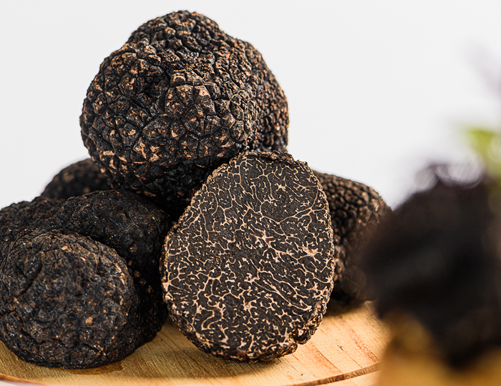

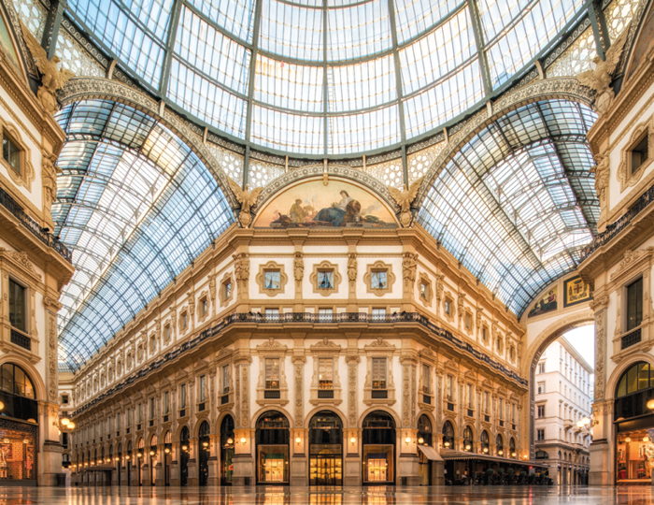
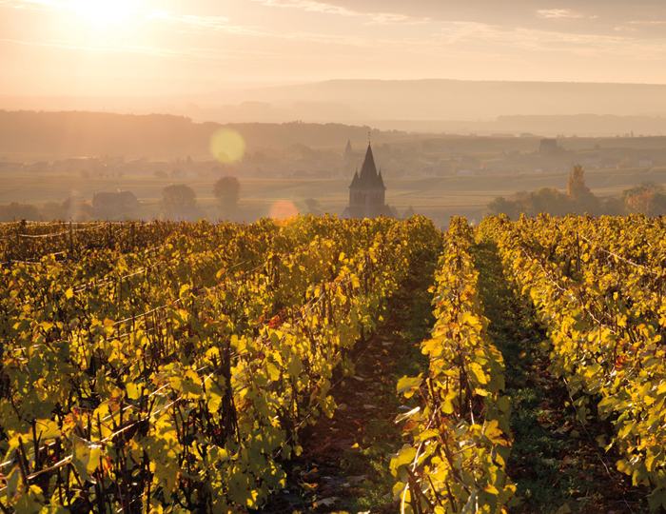
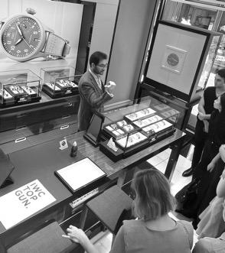
Year
Luxury Immersion Year
Bachelor’s in Luxury Business
Luxury Discovery Trips
SEMESTER 1
Foundation: Luxury Fundamentals
INTRODUCTION TO THE WORLD OF LUXURY
Introduction to
Luxury Business
New Frontiers in
Luxury Tourism
Luxury Codes
and Attitude
LUXURY GUEST EXPERIENCE
Luxury Universe & Industry Insights
Wellness & Wellbeing
Guest Relations
Project Creation and Design
LUXURY PRODUCTS AND SERVICES
Consumer insights & Behavior
Service Excellence and Luxury Fine Food
The Business of Luxury
Wine and Spirits
BUSINESS FUNDAMENTALS
Principles of Marketing
Introduction to IT Business Tools
Accounting Essentials
Effective Communication or Advances English
SECRETS OF SWISS
LUXURY HOSPITALITY
Gastronomic discovery
tour in Switzerland
Michelin-star restaurant experience
Visit renowned producers
LUXURY
IN TIME
Immersion in the world
of luxury watch manufacture
Discover the art
of excellence and craftmanship
in luxury products
ITALIAN
ELEGANCE
Discover the spiritual
home of luxury
Visit famous luxury brands in Italy across fashion
and automobiles
FRANCE: THE LAND OF LUXURY SAVOIR-FAIRE
Emphasis on luxury craftmanship for hand-made luxury items
Discover French fine
wines and spirits
LUXURY
DISCOVERY TRIP
French Savoir Faire
and Excellence
LUXURY
DISCOVERY TRIP
Luxury Hospitality
and Resorts
LUXURY
DISCOVERY TRIPS
Swiss Luxury Manufacturers
and Services
The Essence of
Italian Elegance
SEMESTER 2
Professional Immersion: Internship

Slide 14
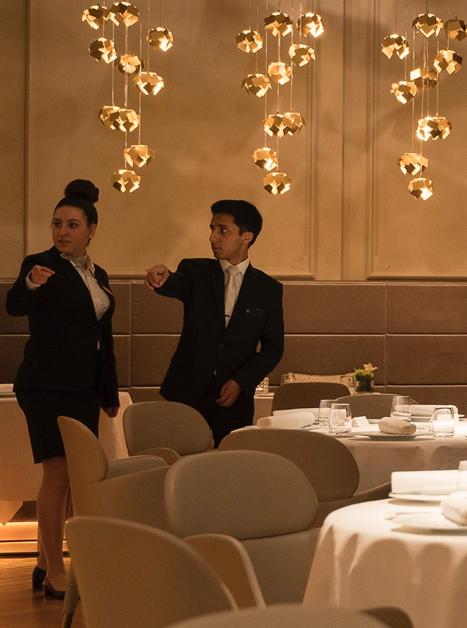
Year
Luxury Immersion Year
Bachelor’s in Luxury Business
Luxury Discovery Trips
Bachelor’s in International Hospitality Business
SEMESTER 1
Foundation: Luxury Fundamentals
SEMESTER 1
Hospitality Excellence (Practical Arts)
SEMESTER 2
Professional Immersion: Internship
INTRODUCTION TO THE WORLD OF LUXURY
Introduction to
Luxury Business
New Frontiers in
Luxury Tourism
Luxury Codes
and Attitude
LUXURY GUEST EXPERIENCE
Luxury Universe
Wellness Operations
Guest Relations
Project Creation and Implementation
LUXURY PRODUCTS AND SERVICES
Luxury Branding and Trends
Service Excellence and Luxury Fine Food
The Business of Luxury
Wine and Spirits
BUSINESS FUNDAMENTALS
Principles of Marketing
Introduction to IT Business Tools
Accounting Essentials
Effective Communication or English Advanced
Service Excellence
Rooms Division
Culinary Arts
Food & Beverage Practical Application
Universe of Wine
Wellness Operations
Consumer Insights and Behavior
Operational Budgeting
Introduction to IT Tools
Effective Communication or English Advanced
Acquire & evaluate information
Apply new knowledge
Develop appropriate workplace behaviors
SECRETS OF SWISS
LUXURY HOSPITALITY
Gastronomic discovery
tour in Switzerland
Michelin-star restaurant experience
Visit renowned producers
LUXURY
IN TIME
Immersion in the world
of luxury watch manufacture
Discover the art
of excellence and craftmanship
in luxury products
ITALIAN
ELEGANCE
Discover the spiritual
home of luxury
Visit famous luxury brands in Italy across fashion
and automobiles
FRANCE: THE LAND OF LUXURY SAVOIR-FAIRE
Emphasis on luxury craftmanship for hand-made luxury items
Discover French fine
wines and spirits
LUXURY
DISCOVERY TRIP
French Savoir Faire
and Excellence
LUXURY
DISCOVERY TRIP
Luxury Hospitality
and Resorts
LUXURY
DISCOVERY TRIPS
Swiss Luxury Manufacturers
and Services
The Essence of
Italian Elegance
SEMESTER 2
Professional Immersion: Internship
TWO-WEEK MASTERCLASS IN LUXURY GASTRONOMY
& HOSPITALITY IN SWITZERLAND
Practical & transferable skills
Luxury hospitality branding & trends
Contemporary gastronomy, F&B & bar

Slide 15
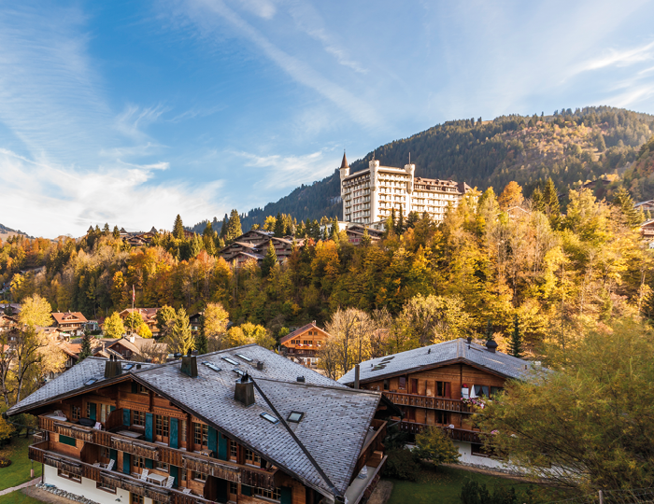
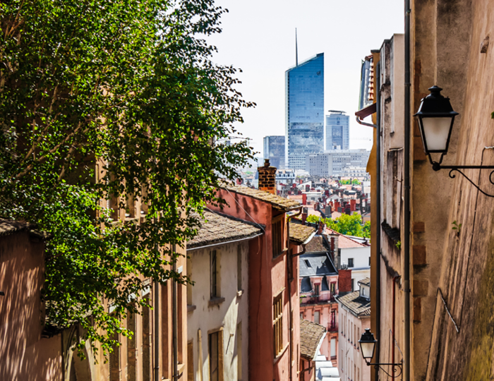
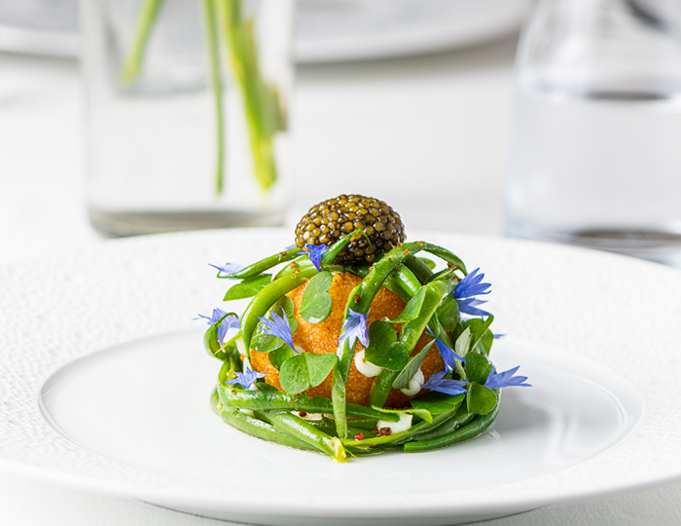
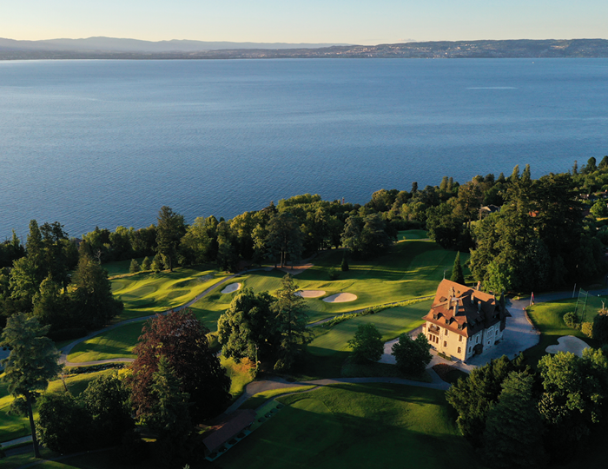
Year
Experiential Year
Luxury Discovery Trips
Bachelor’s in International Hospitality Business
Luxury Gastronomy & Hospitality Masterclass
SEMESTER 1
Hospitality Excellence (Practical Arts)
SEMESTER 2
Professional Immersion: Internship
Service Excellence
Rooms Division
Culinary Arts
Food & Beverage Practical Application
Universe of Wine
Wellness and Wellbeing
Consumer Insights and Behavior
Operational Budgeting
Introduction to IT Tools
Effective Communication or Advanced English
Acquire & evaluate information
Apply new knowledge
Develop appropriate workplace behaviors
SECRETS OF SWISS
LUXURY HOSPITALITY
Gastronomic discovery
tour in Switzerland
Michelin-star restaurant experience
Visit renowned producers
LUXURY
IN TIME
Immersion in the world
of luxury watch manufacture
Discover the art
of excellence and craftmanship
in luxury products
ITALIAN
ELEGANCE
Discover the spiritual
home of luxury
Visit famous luxury brands in Italy across fashion
and automobiles
FRANCE: THE LAND OF LUXURY SAVOIR-FAIRE
Emphasis on luxury craftmanship for hand-made luxury items
Discover French fine
wines and spirits
DISCOVER THE BEST
OF SWITZERLAND
Gastronomic discovery
tour in Switzerland
Discover caviar, fine
wines & truffles
Meet leading hoteliers in Gstaad
ENJOY A TASTE OF
LUXURY IN LYON
Two-day trip to Lyon, France
5-star hotel stay
Lunch in a two
Michelin-star restaurant
Visit Europe’s first
wine theme park
EXPLORE THE UNIVERSE OF
A MICHELIN-STAR MAESTRO
Explore the philosophy
of Stéphane Décotterd
Fine-dining experience
at Maison Décotterd
Workshop with Relais
& Châteaux
EXPERIENCE TWO DAYS OF NATURE & NURTURE IN EVIAN
Visit to a thermal spa
5-star hotel visit
Q&As with leading
TWO-WEEK MASTERCLASS IN LUXURY HOSPITALITY
& GASTRONOMY
Practical & transferable skills
Luxury hospitality branding & trends
Contemporary gastronomy, F&B & bar
Notes:
Semester 1
In this semester, students are expected to apply previous knowledge to real hospitality work environments. The practical experience in the field allows students to demonstrate understanding of professional practices and to expand their perspective on what it means to be a professional in the hospitality industry. During the internship, students should develop an understanding of workplace diversity.
Upon successful completion of the internship, students should be able to acquire and evaluate information in professional settings and to develop appropriate workplace behaviors.
Semester 2
In this semester, students are expected to apply previous knowledge to real hospitality work environments. The practical experience in the field allows students to demonstrate understanding of professional practices and to expand their perspective on what it means to be a professional in the hospitality industry. During the internship, students should develop an understanding of workplace diversity.
Upon successful completion of the internship, students should be able to acquire and evaluate information in professional settings and to develop appropriate workplace behaviors.

Slide 16
Year
Experiential Year
Bachelor’s in International Hospitality Business
Luxury Gastronomy & Hospitality Masterclass
SEMESTER 1
Hospitality Excellence (Practical Arts)
SEMESTER 2
Professional Immersion: Internship
Service Excellence
Rooms Division
Culinary Arts
Food & Beverage Practical Application
Universe of Wine
Wellness Operations
Consumer Insights and Behavior
Operational Budgeting
Introduction to IT Tools
Effective Communication or English Advanced
Acquire & evaluate information
Apply new knowledge
Develop appropriate workplace behaviors
DISCOVER THE BEST
OF SWITZERLAND
Gastronomic discovery
tour in Switzerland
Discover caviar, fine
wines & truffles
Meet leading hoteliers in Gstaad
ENJOY A TASTE OF
LUXURY IN LYON
Two-day trip to Lyon, France
5-star hotel stay
Lunch in a two
Michelin-star restaurant
Visit Europe’s first
wine theme park
EXPLORE THE UNIVERSE OF
A MICHELIN-STAR MAESTRO
Explore the philosophy
of Stéphane Décotterd
Fine-dining experience
at Maison Décotterd
Workshop with Relais
& Châteaux
EXPERIENCE TWO DAYS OF NATURE & NURTURE IN EVIAN
Visit to a thermal spa
5-star hotel visit
Q&As with leading
TWO-WEEK MASTERCLASS IN LUXURY GASTRONOMY
& HOSPITALITY IN SWITZERLAND
Practical & transferable skills
Luxury hospitality branding & trends
Contemporary gastronomy, F&B & bar

Slide 17

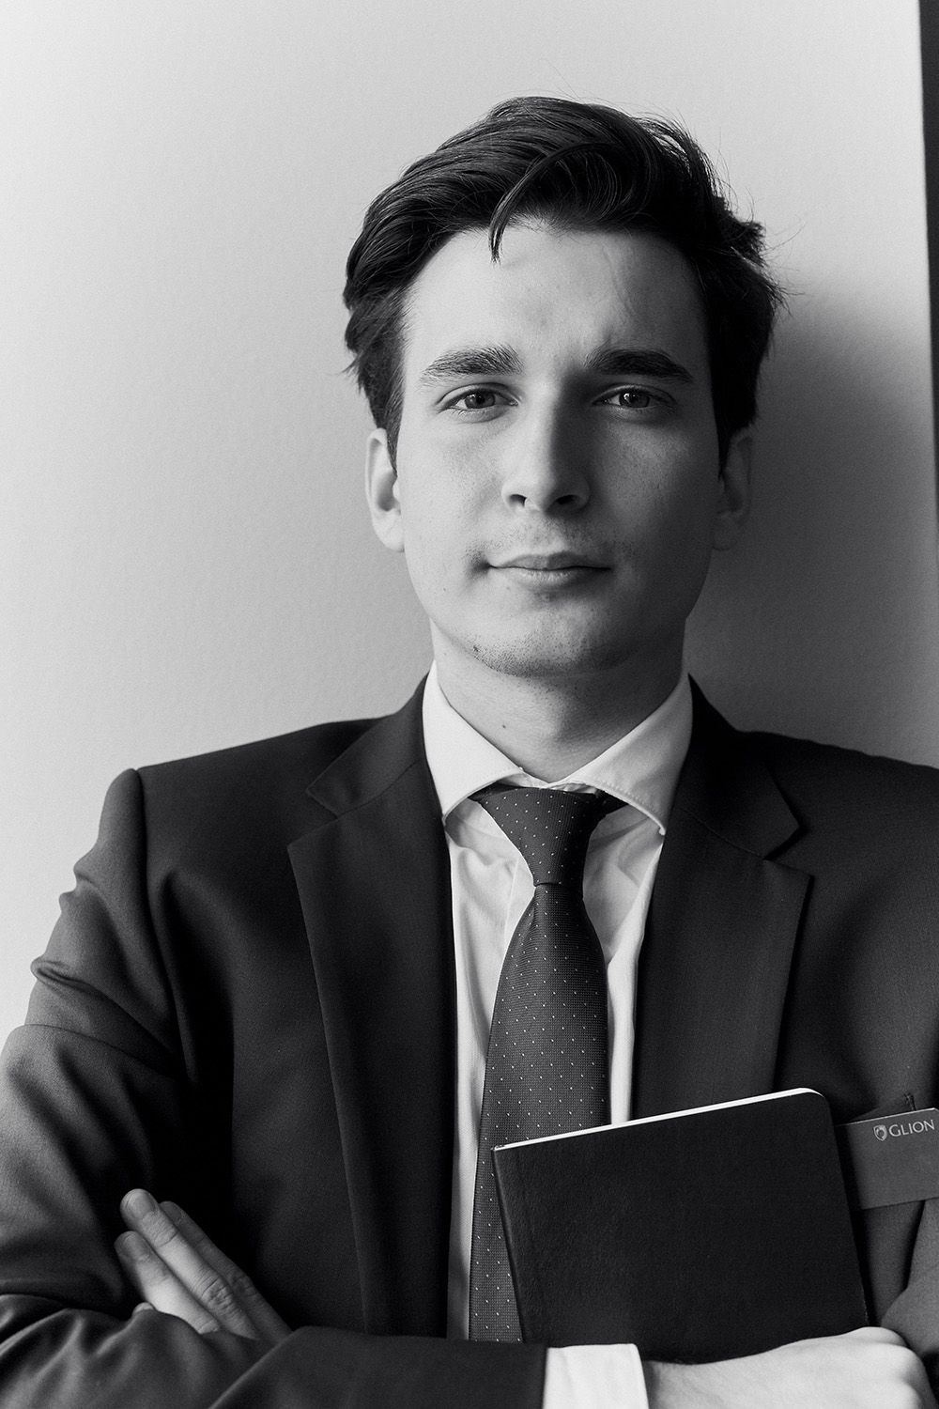
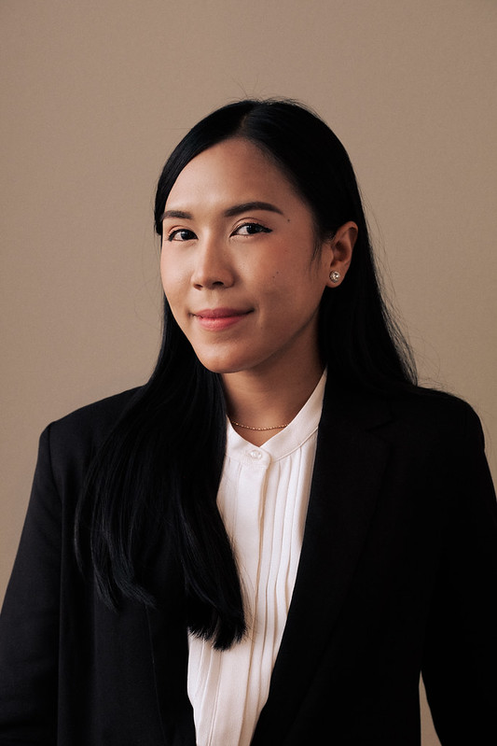
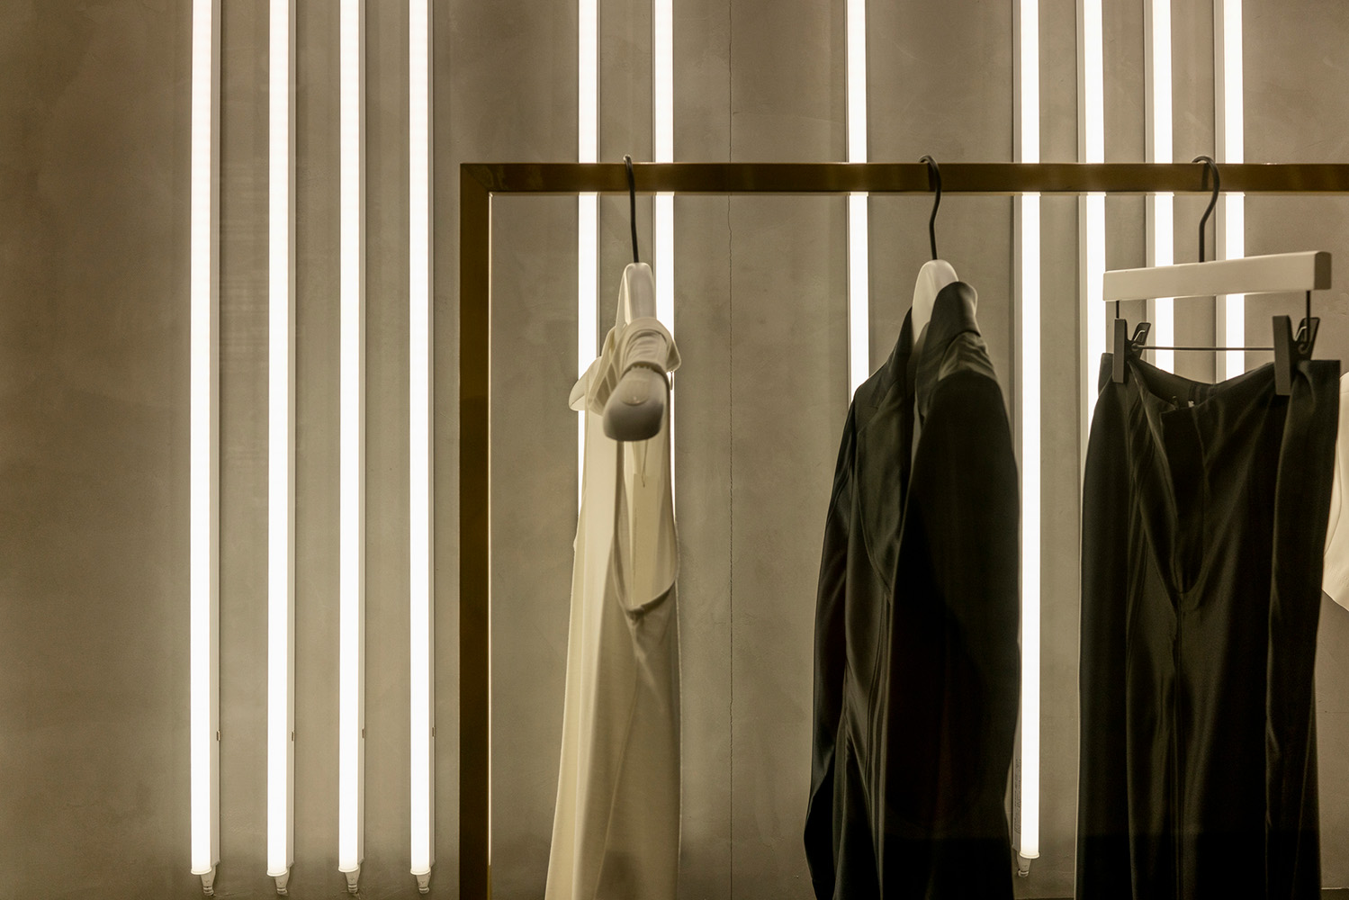
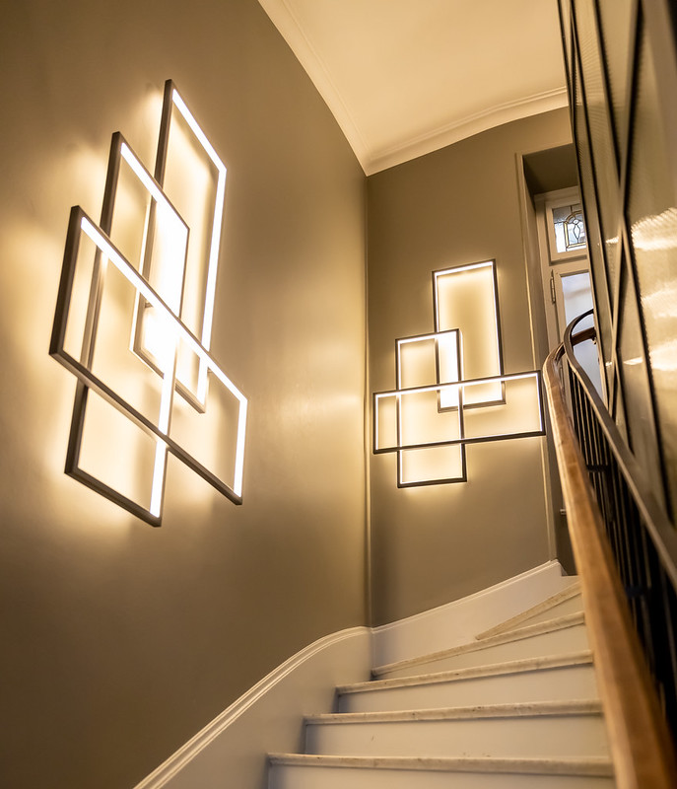
Year
Bachelor of Science
Bachelor’s in Luxury Business
Bachelor’s in International Hospitality Business
SEMESTER 1
Luxury Management I
SEMESTER 2
Luxury Management II
SEMESTER 1
Hospitality Fundamentals
SEMESTER 2
Hospitality Management
Psychology of Luxury and the Luxury Client
Introduction to Management
Financial Statement Analysis
Luxury Marketing Essentials
Human Behavior in the Workplace
Trends in Luxury Business
IT Business Tools
Sales and Distribution Channels
Data Analysis for Decision Makers
Bidding & Negotiation
Integrated Digital Marketing
Legal Environment of Luxury Industries
Business and Academic Research Method
APPLIED PROJECT
Hospitality Marketing Essentials
Hospitality Financial Accounting
Professional Communication
and Academic Writing
Human Behavior in the Workplace
Hospitality and Events Operations
IT Business Tools
General Education Elective
Integrated Marketing
Communication in the Digital Era
Managerial Accounting
Management of Rooms
Economics for Hospitality
and the Tourism Industry
Data Analysis for Decision Makers
Concept Development and Entrepreneurship
in Food and Beverage Management
General Education Elective
Decision making skills
Interpersonal competencies
Key concepts & managerial principles
Innovative solutions
Managerial decisions
Self-development opportunities

Slide 18
Year
Bachelor of Science
Bachelor’s in Luxury Business
Bachelor’s in International Hospitality Business
SEMESTER 1
Luxury Management I
SEMESTER 2
Luxury Management II
SEMESTER 1
Hospitality Fundamentals
SEMESTER 2
Hospitality Management
Psychology of Luxury and the Luxury Client
Introduction to Management
Financial Statement Analysis
Luxury Marketing Essentials
Human Behavior in the Workplace
Trends in Luxury Business
Sales and Distribution Channels
Data Analysis for Decision Makers
Bidding & Negotiation
Integrated Digital Marketing
Legal Environment of Luxury Industries
Business and Academic Research Method
LUXURY BUSINESS APPLIED PROJECT
Hospitality Marketing Essentials
Hospitality Financial Accounting
Professional Communication
and Academic Writing
Human Behavior in the Workplace
Hospitality and Events Operations
IT Business Tools
General Education Elective
Integrated Marketing
Communication in the Digital Era
Managerial Accounting
Management of Rooms
Economics for Hospitality
and the Tourism Industry
Data Analysis for Decision Makers
Concept Development and Entrepreneurship
in Food and Beverage Management
General Education Elective
Decision making skills
Interpersonal competencies
Key concepts & managerial principles
Innovative solutions
Managerial decisions
Self-development opportunities
Notes:
Semester 3
In this semester students will continue the transition from semester one, through the students’ first internship, to the introduction of key concepts and managerial principles across a range of hospitality settings. The semester will build on the practical elements of operational management and at the same time develop a fundamental understanding of the characteristics of running a hospitality business.
Upon successful completion of the semester, students should be able to apply knowledge and skills in decision making. Students also develop interpersonal competencies through academic learning and industry focused study, preparing them for professional environments.
Semester 4
In this semester, students will be immersed into management domains with a focus on exploring innovative solutions to challenges faced by hospitality professionals in a constantly changing environment. The courses include both macro and micro perspectives and should result in the students developing their abilities to analyze and reflect on concepts and factual data essential to problem solving in the hospitality industry.
Upon successful completion of the semester, the students should be able to generate principled and effective managerial decisions and reflect upon self-development opportunities.

Slide 19

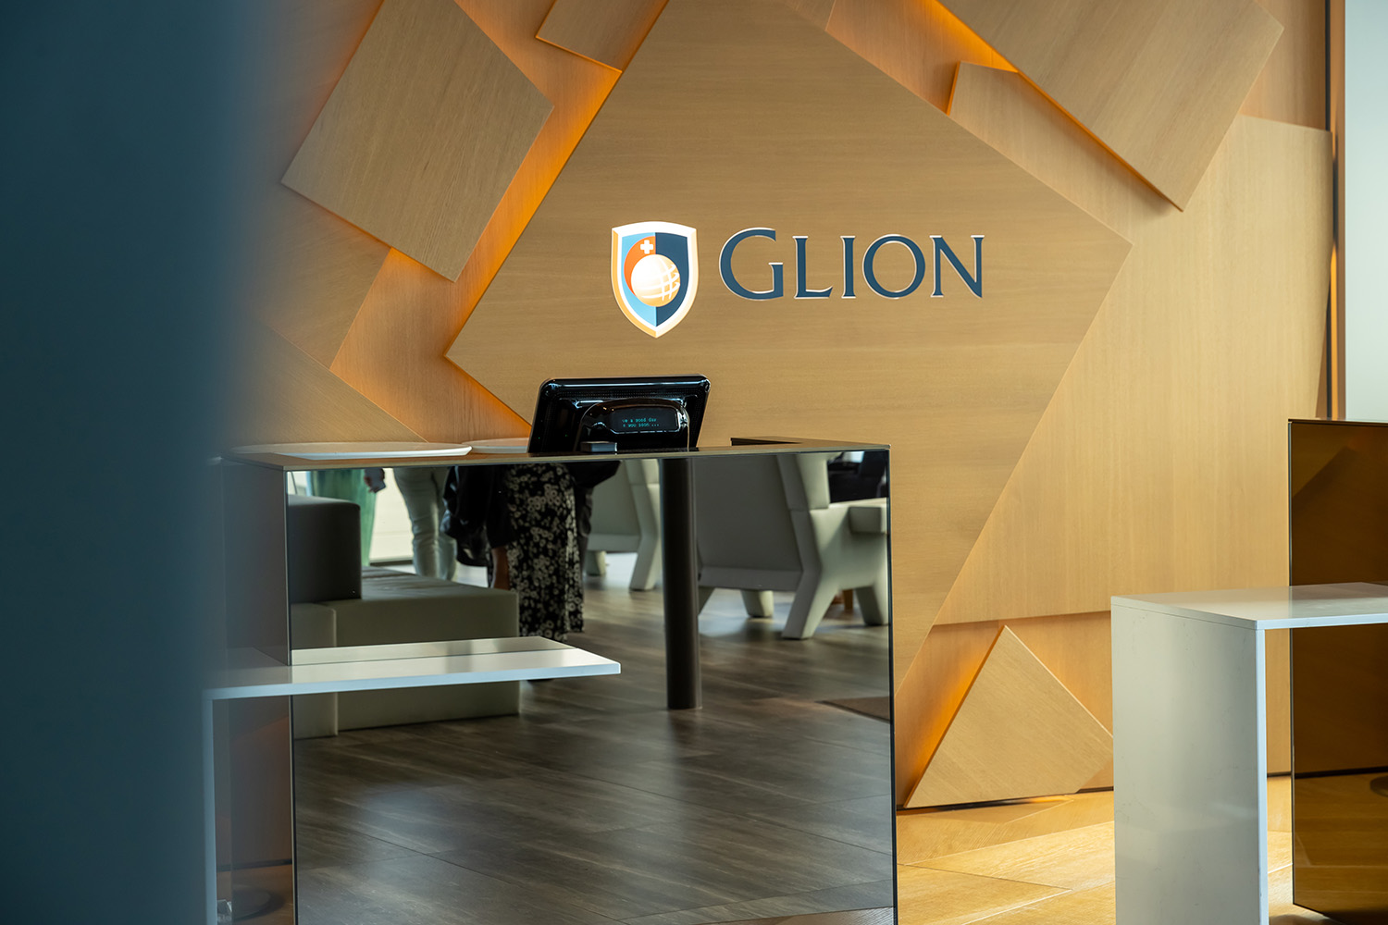

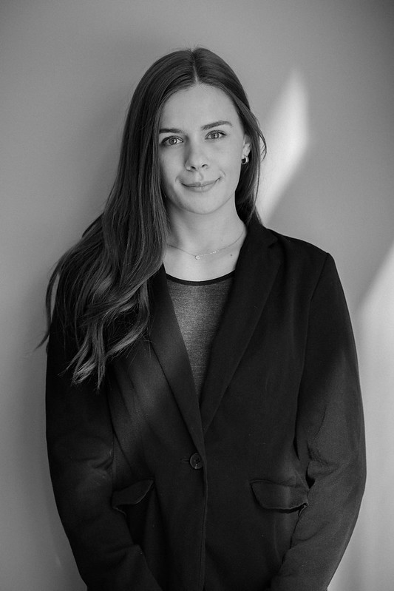

Year
Bachelor of Science
Bachelor’s in Luxury Business
Bachelor’s in International Hospitality Business
SEMESTER 3
Management Practice: Internship
SEMESTER 4
Strategic Luxury Leadership
SEMESTER 3
Management Practice: Internship
SEMESTER 4
Integrative Business Strategies
Market Research and Analysis
Corporate Social Responsibility
Corporate Finance
Supply Chain Management
Leadership Skills for Change Management
Business Development
Social Media and Public Relations
Academic Research Methods
Business Development and Strategy
Corporate Finance
Leadership Skills for Change Management
Revenue Management and Distribution Management
Human Resources Talent Management
Sustainability in Ethical Business
Business and Academic Research Methods
Real-life managerial approaches
Problem-solving & critical thinking
Return to industry
Develop a strategic mindset
Apply business theory
Recommend solutions at corporate level

Slide 20
Year
Bachelor of Science
Bachelor’s in Luxury Business
Bachelor’s in International Hospitality Business
SEMESTER 3
Management Practice: Internship
SEMESTER 4
Strategic Luxury Leadership
SEMESTER 3
Management Practice: Internship
SEMESTER 4
Integrative Business Strategies
Market Research and Analysis
Corporate Social Responsibility
Corporate Finance
Supply Chain Management
Leadership Skills for Change Management
Business Development
Social Media and Public Relations
Academic Research Methods
Business Development and Strategy
Corporate Finance
Leadership Skills for Change Management
Revenue Management and Distribution Management
Human Resources Talent Management
Sustainability in Ethical Business
Business and Academic Research Methods
Real-life managerial approaches
Problem-solving & critical thinking
Return to industry
Develop a strategic mindset
Apply business theory
Recommend solutions at corporate level
Notes:
Semester 6
In this semester, students are immersed in developing competencies in order to implement successful business strategies. Students are expected to develop a strategic mindset and apply business theory to complex and ambiguous scenarios and be able to recommend strategic alternatives at a corporate and business unit level.
Upon successful completion of the semester, students should have developed their core business acumen in preparation for their final semester specialization and capstone project.

Slide 21

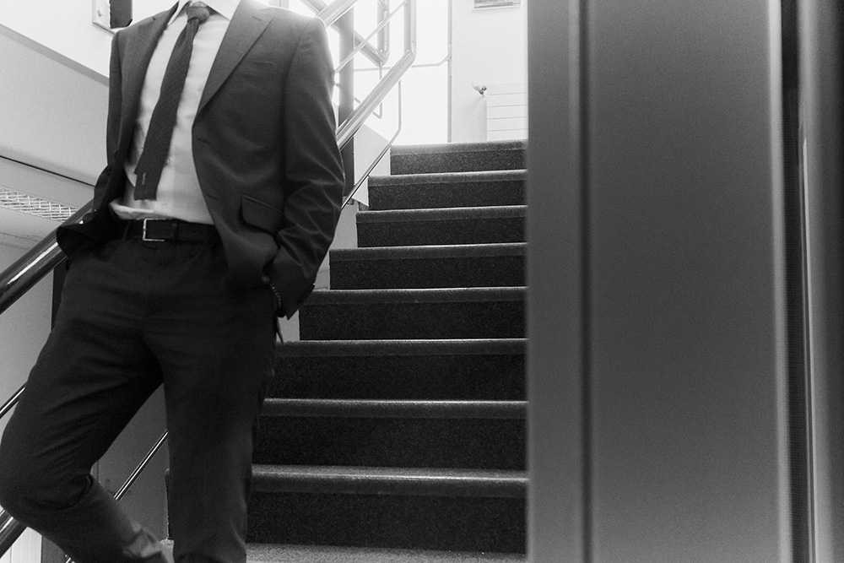
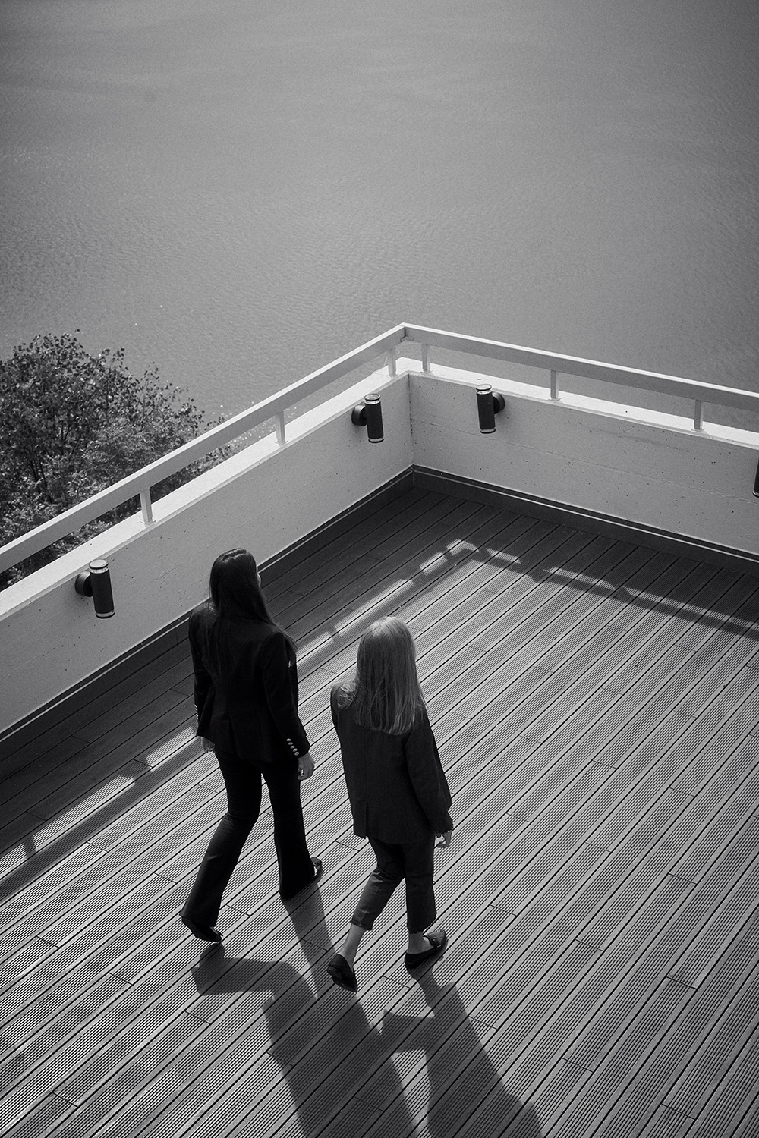

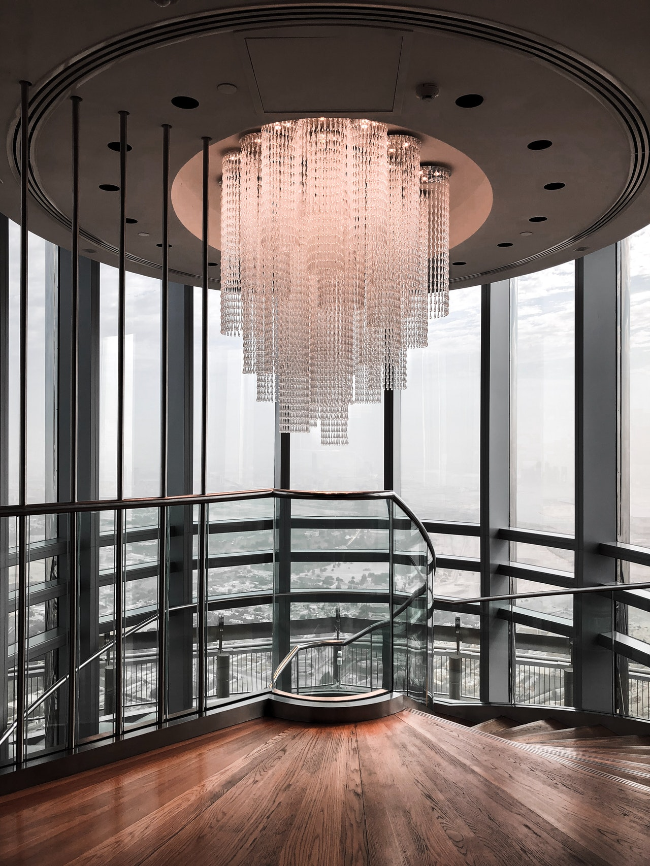
Year
Bachelor of Science
Bachelor’s in Luxury Business
Bachelor’s in International Hospitality Business
SEMESTER 5
Crafting Tomorrow’s Luxury
SEMESTER 6
Industry work experience
SEMESTER 5
Specialization & Business Project
SEMESTER 6
Industry work experience
Architecture, Design and Scenography
Strategic Management
Design Thinking
Sustainable Luxury and Design
New Technologies in Luxury Businesses
ENTREPRENEURIAL CHALLENGE
BUSINESS FIELD TRIP
BACHELOR THESIS OR APPLIED BUSINESS PROJECT
ON-THE-JOB EXPERIENCE
Bachelor's thesis or Applied Business Project
12-weeks in the luxury industry
CHOICE OF SPECIALIZATION
Luxury Brand Strategy
or
International Hotel Development and Finance
or
Guest Experience and Event Management
And
Bachelor’s Thesis or Applied Business Project
+ SPECIALIZATION-BASED FIELD TRIP
ON-THE-JOB EXPERIENCE
Bachelor’s Thesis or Applied Business Project
12 weeks in the hospitality industry
Reflect on specialist knowledge
Openness to new ideas
Creativity & innovation

Slide 22
is this program for?
Ambitious, creative and globally-minded students
Aspiring to work with prestigious global brands
Passionate about luxury brands, fashion, hospitality, real estate and high-end services
Seeking to master luxury customer experience and brand storytelling
Diligent entrepreneurs in the luxury industry
opportunities
Luxury Brand Management
fashion, watches, jewelry, automobiles
Real Estate & Yachting
high-end property development, yacht management
Luxury Retail & Merchandising
flagship stores, personal shopping
Entrepreneurship
launching a luxury brand
or boutique business
BACHELOR’S IN LUXURY BUSINESS
Luxury Marketing & PR
digital marketing, event planning, influencer collaborations
Luxury Hospitality & Travel
hotels, private concierge services

Slide 23
Year
Bachelor of Science
Bachelor’s in Luxury Business
Bachelor’s in International Hospitality Business
SEMESTER 5
Crafting Tomorrow’s Luxury
SEMESTER 6
Industry work experience
SEMESTER 5
Specialization & Business Project
SEMESTER 6
Industry work experience
Architecture, Design and Scenography
Strategic Management
Design Thinking
Sustainable Luxury and Design
New Technologies in Luxury Businesses
ENTREPRENEURIAL CHALLENGE
BUSINESS FIELD TRIP
BACHELOR THESIS OR APPLIED BUSINESS PROJECT
ON-THE-JOB EXPERIENCE
Bachelor's thesis or Applied Business Project
12-weeks in the luxury industry
CHOICE OF SPECIALIZATION
Luxury Brand Strategy
or
International Hotel Development and Finance
or
Guest Experience and Event Management
And
Bachelor’s Thesis or Applied Business Project
+ SPECIALIZATION-BASED FIELD TRIP
ON-THE-JOB EXPERIENCE
Bachelor’s Thesis or Applied Business Project
12 weeks in the hospitality industry
Reflect on specialist knowledge
Openness to new ideas
Creativity & innovation
Notes:
Semester 7
In this semester, students will be immersed into management domains with a focus on exploring innovative solutions to challenges faced by hospitality professionals in a constantly changing environment. The courses include both macro and micro perspectives and should result in the students developing their abilities to analyze and reflect on concepts and factual data essential to problem solving in the hospitality industry.
Upon successful completion of the semester, the students should be able to generate principled and effective managerial decisions and reflect upon self-development opportunities.

Slide 24
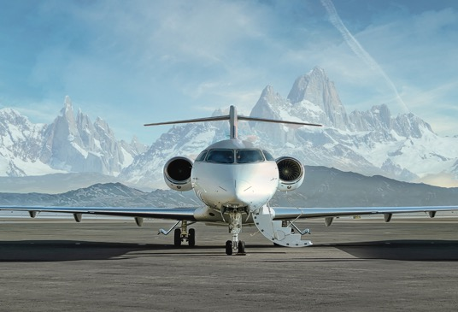
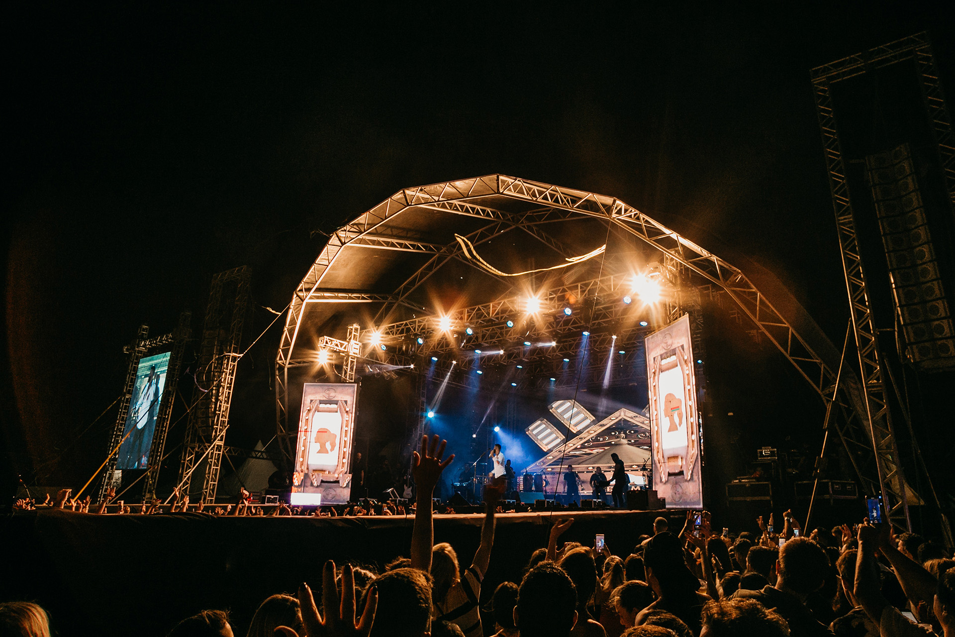
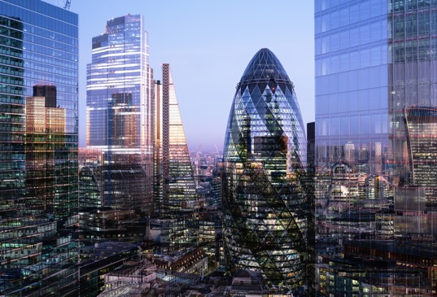

Luxury Brand Strategy
Guest Experience and Event Management
International Hotel Development & Finance
specializations
Understanding Luxury Concepts
Building Luxury Brand Identity
Utilizing Marketing Communication Tools
Designing Luxury Experiences
Delivering Service Excellence
in the Luxury Sector
Defining the Experience Industry
Creating the Strategy & Management in Hospitality, Events, Tourism
Developing a Personalized Offering & Upsell Programs
Staging a Blended Hospitality Experience
Designing Customer Feedback Management Systems
Hotel Asset Management Introduction
Hotel feasibility and
international development
Hotel Finance and Valuation
Global Resort Development
EMEA Hotel Market Development
Notes:
Luxury Brand Strategy
International Event Management
International Hotel Development and Finance

Slide 25
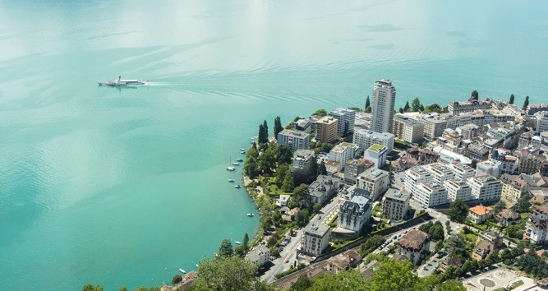

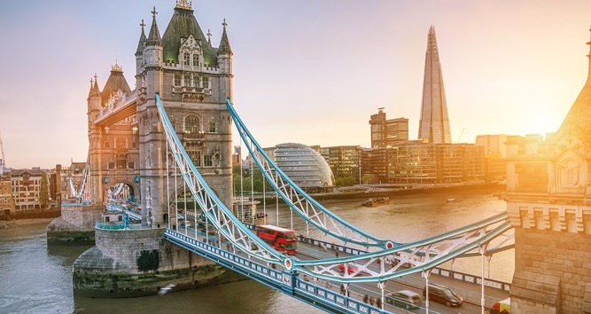



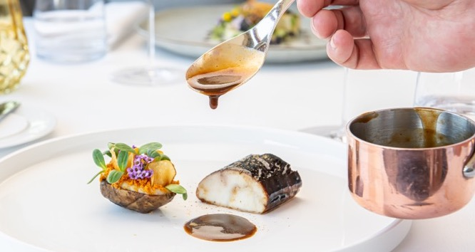
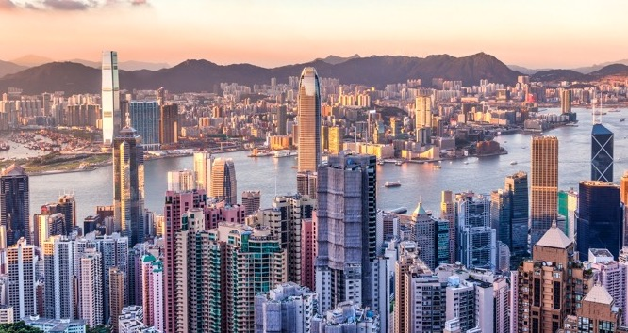
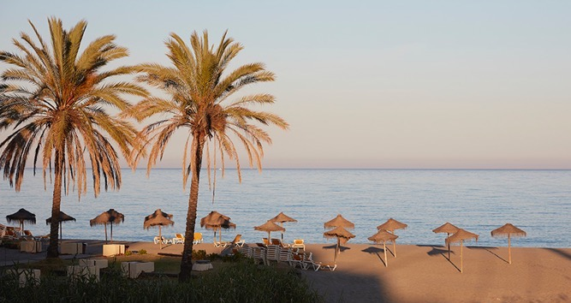

Glion campus,
Switzerland
Bulle campus,
Switzerland
London campus,
United Kingdom
in up to 7 locations
Experiential Year
Bachelor of Science
Semester 1
Semester 3
INTERNSHIP
Semester 6
ON-THE-JOB
Semester 1
Semester 2
INTERNSHIP
Semester 3
INTERNSHIP
Semester 6
ON-THE-JOB
Semester 2
INTERNSHIP
Semester 2
Semester 4
Semester 5
Semester 1
Semester 2
Semester 4
Semester 5
Semester 1
MASTERCLASS
Luxury Gastronomy
& Hospitality
Worldwide
Les Roches Marbella, Spain

Slide 26
is this program for?
Students passionate about hospitality, tourism, and event management
Those who aspire to work in international business, luxury hospitality, or entrepreneurship
Individuals seeking a dynamic, customer-centric career
Future leaders who want to develop management, finance,
and operational skills
Those eager to experience global internships and industry exposure
opportunities
Hotel & Resort Management
luxury and boutique brands
Luxury Retail & Customer Experience Management
Tourism & Travel Industry
airlines, cruise lines, tour operators
Entrepreneurship
launching hospitality or service-related businesses
BACHELOR’S IN INTERNATIONAL HOSPITALITY BUSINESS
Event & Experience Management
corporate events, sports hospitality, luxury weddings
Food & Beverage Management
fine dining, restaurant chains, catering services
Hospitality Real Estate
& Development

Slide 27
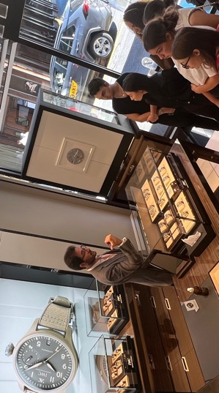
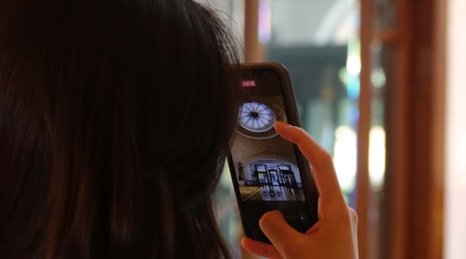
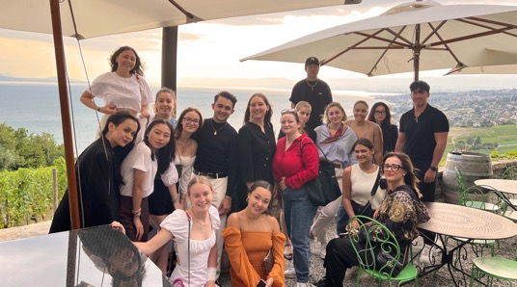

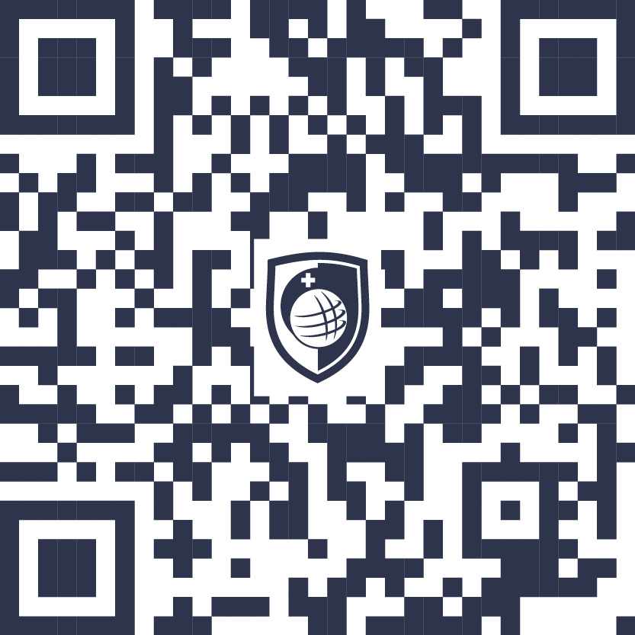
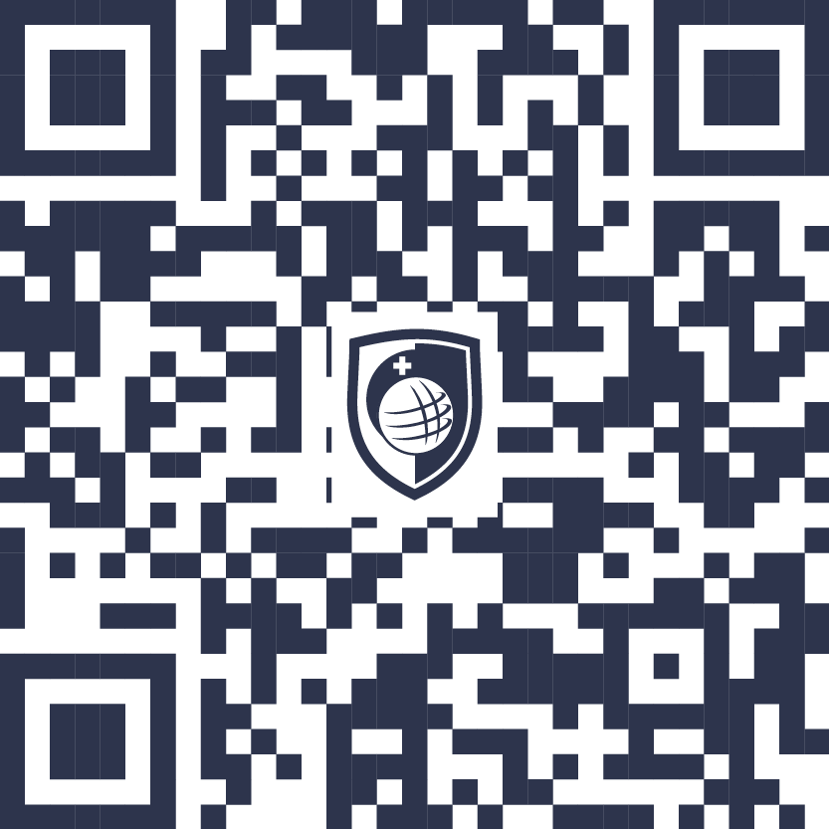
programs
Hospitality Business Summer Program
Luxury Business Summer Program
Luxury Hospitality Summer Program
FOR 15-17 YEAR OLDS
FOR 15-17 YEAR OLDS
FOR 18+ YEAR OLDS
01
London, UK
One week program
19-26 July 2026
01
Glion/Montreux, Switzerland
One week program
12-19 July 2026
01
Glion/Montreux, Switzerland
One week program
19-26 July 2025
02
Glion/Montreux, Switzerland
One week program
26 July – 02 August 2026
03
UK & Switzerland
Two week program
19 July – 02 August 2026
Summer programs for
15-17 y/o
Summer programs for
18+ y/o
Notes:
Luxury Brand Strategy
International Event Management
International Hotel Development and Finance

Slide 28


requirements
ADMISSIONS PROCESS & SUPPORT

Slide 29

Bachelor’s degrees
entry requirements
MINIMUM AGE
17.5 years old
EDUCATION
Completed senior secondary education with a diploma
ENGLISH LANGUAGE QUALIFICATIONS
2 years in a school where English is the primary language of instruction
IELTS: 5.5 overall
TOEFL: IBT 70 / PBT 525
First Cambridge Exam: grade C
For London, non-EU/EEA passport holders will need to undertake IELTS for UKVI

Slide 30


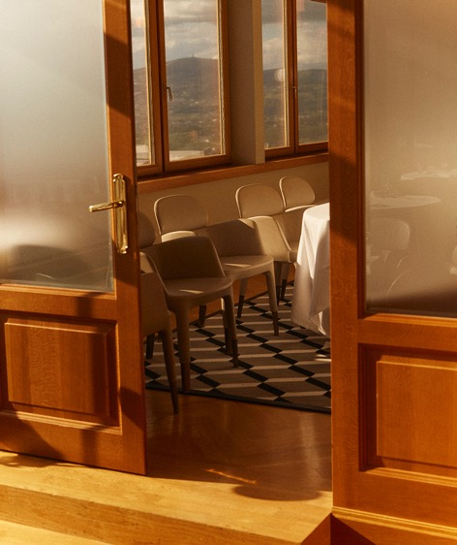






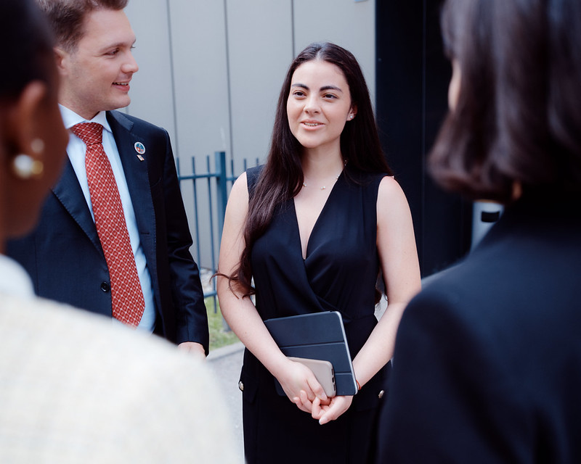
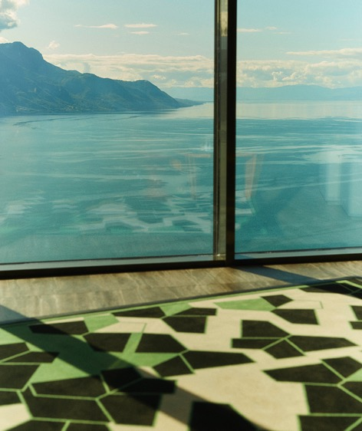


Receive your evaluation
If successful, within
1-2 weeks
Finalize your application form
Arrive on campus
process
Submit
your documents
Confirm your place
Within 15 working
days of receiving your letter of offer
Get pre-arrival support and meet your peers

Slide 31
Receive your evaluation
If successful, within
1-2 weeks
Finalize your application form
Arrive on campus
process
Submit
your documents
Confirm your place
Within 15 working
days of receiving your letter of offer
Get pre-arrival support and meet your peers

Slide 32
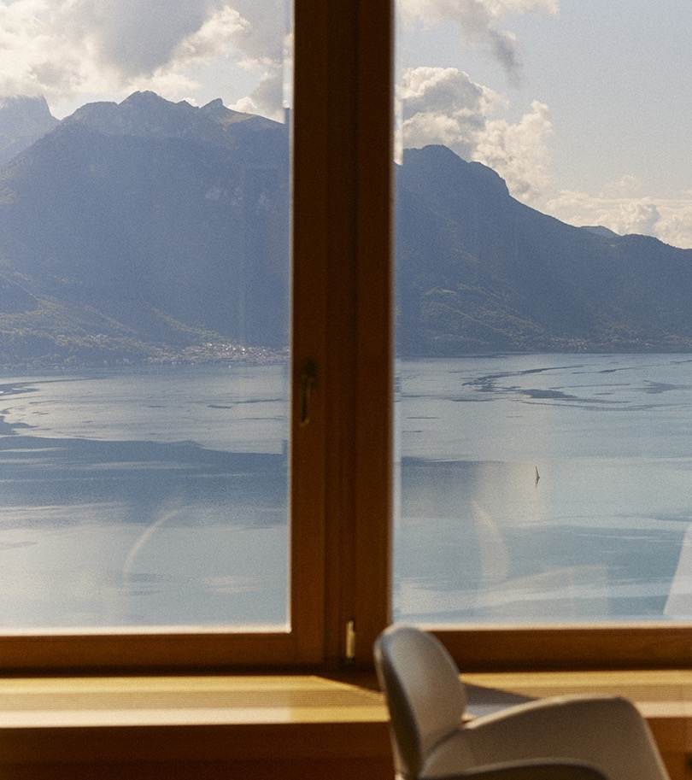
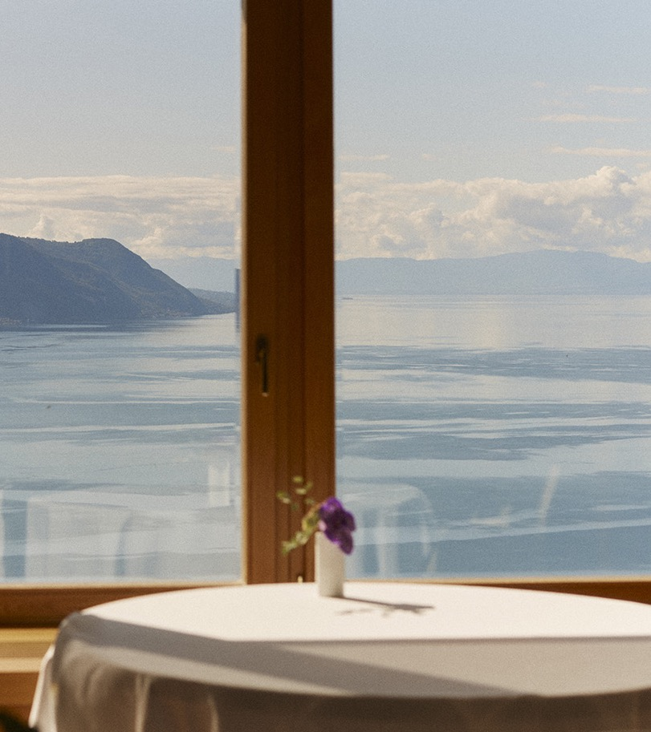


questions?

Slide 33






Follow us:
linktr.ee/glion.edu

