Slide 1
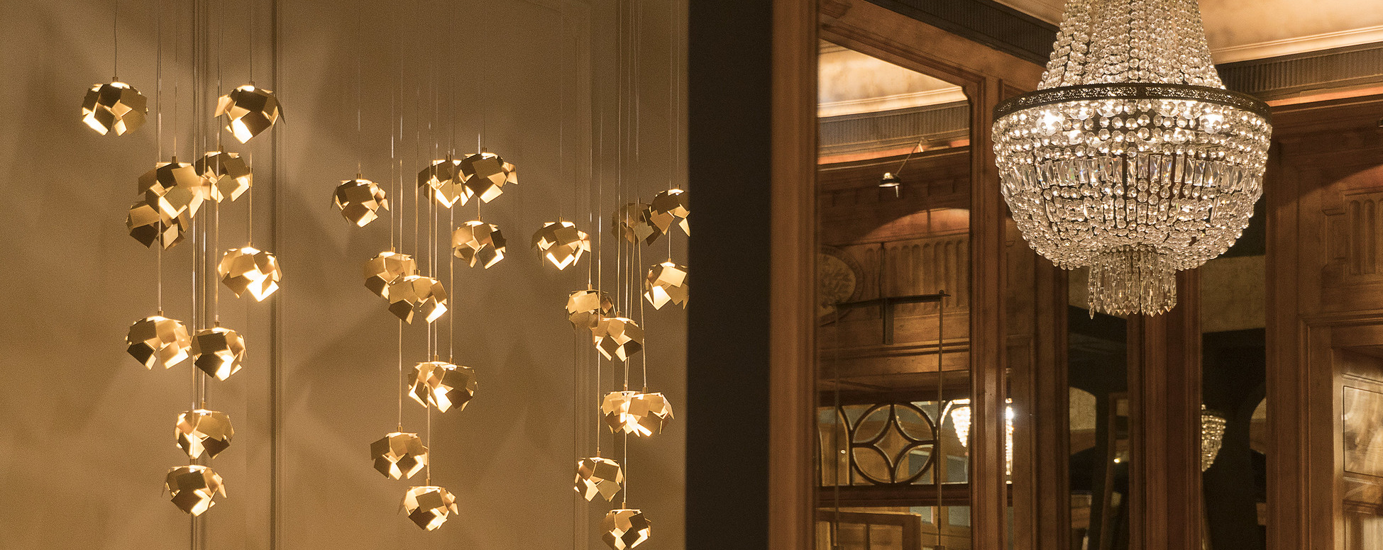


Executive Master’s in Luxury Management & Guest Experience

Slide 2
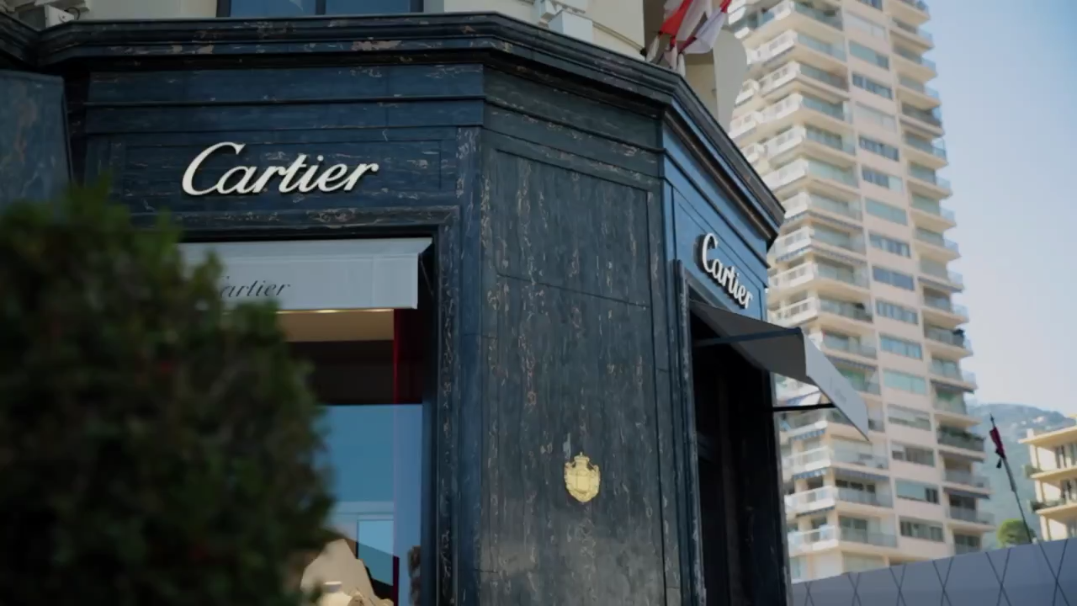
Are you building a career
in 5* hospitality, luxury goods, private travel or another part of this vibrant industry?
Perhaps you are looking to make the switch into luxury?
Do you have a
passion for luxury?

Slide 3
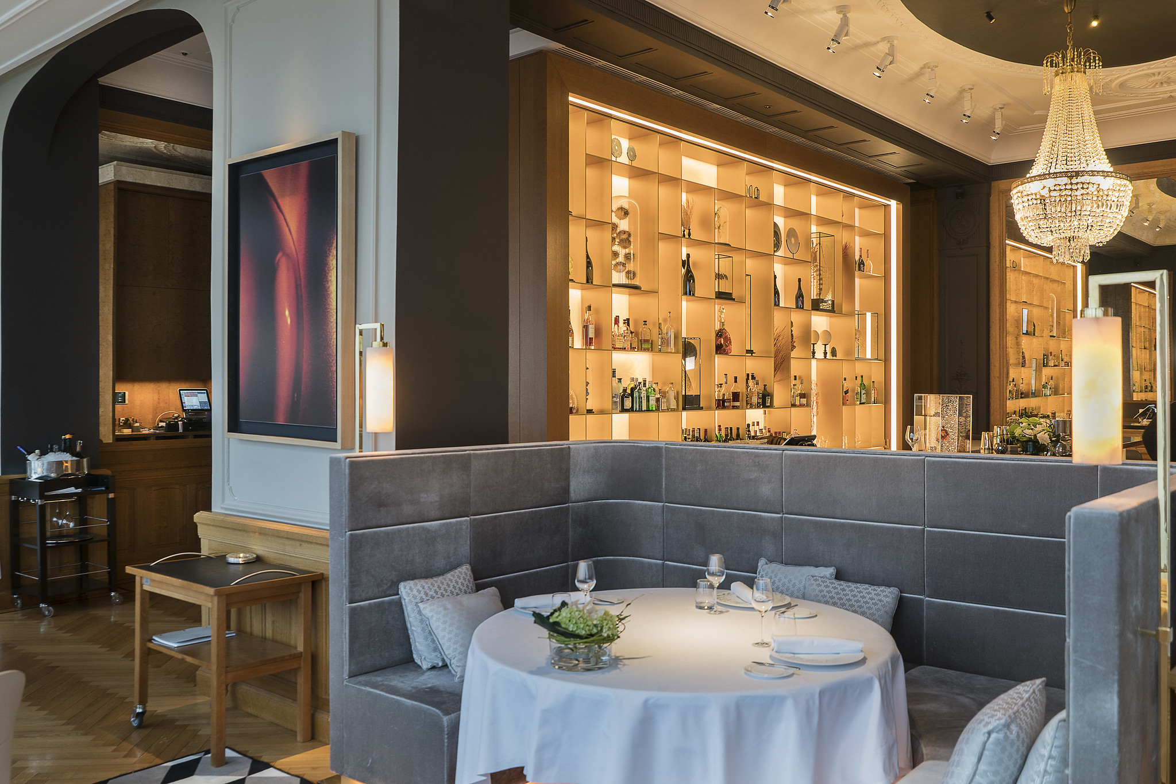

Celebrating
60 years of Experience Excellence in 2022
We offer luxury & hospitality
business education
Our programs are
infused with luxury
Our faculty & lecturers
have backgrounds in industry & academia
About Glion
We partner with world-renowned
luxury brands

Slide 4

Focus on business-critical
areas: digital transformation, sustainability & understanding customer behavior
Flexible study plan
to balance with your professional role
Hand-picked faculty comprised of
senior industry professionals
Individual coaching
by a professional executive coach
Why choose
this Executive Master’s?
Connect & network
with an executive-level peer group
& join Glion’s vast alumni community

Slide 5

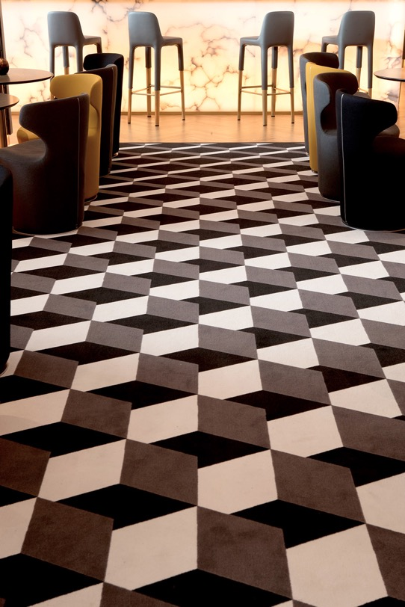
Your Executive Master’s
study pathway
2 residential weeks on Glion campuses including local field trips
Duration
12 Months
Delivery Mode
4 distance learning online modules
of 12 weeks
2 face-to-face sessions of 5 days
on Glion campuses
1 Business Research Project to be completed within 15 months after start of the program
Intakes
October and April
Module 1
Module 2
Module 3
Module 4
Business Research Project*
Executive Master’s
Business Research Project
Online Delivery
Online Delivery
Online Delivery
Online Delivery
Optional extra time
12-month program
Module 4
1 week residential in
Glion-Montreux
1 week residential in
London
Business Research Project
*Business Research Project can be completed up to 15 months from the start of your program.

Slide 6
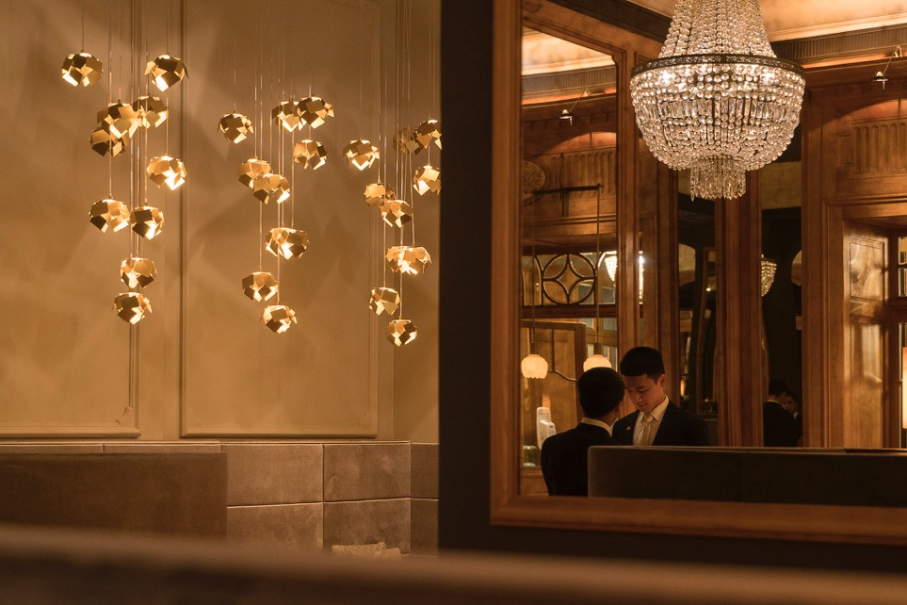
Program details
Module 1
(incl. 1 residential week on Glion campus)
Exploring New Luxury Ecosystems
Luxury Markets, Companies and Societies
New trends in luxury
(with Masterclass in Ultra Luxury experiences)
Sustainable Luxury
Intercultural Leadership, managing inclusion and diversity
High Gastronomy and Fine Dining
(including 1 day Workshop)
Module 3
(incl. 1 residential week on London campus)
Delivering Excellence in
Guest Experiences
Service Culture and Operational Excellence
Impactful Design for Retail and Hospitality
Retail Management and distribution channels
Experiential Economics
Behavioural Aspects of Customer Engagement
Business Research Project
Develop, analyze,
and synthesize a business problem
Establish recommendations
to management
Residential week 1
on Glion campus
Gastronomy hands-on workshop
Module 2
Branding in the Digital World
Building Brand Equity
Ecommerce & omnichannel strategy
in Luxury Industries
Digital Marketing and Communication
in the Luxury Industry
Digital Transformation and Data Analytics
Blockchain in the Luxury Industry
Module 4
Implementing a Sustainable
Luxury Strategy
Strategic Management of Luxury Brands
Sustainable Business Models
Corporate Finance and Value Creation
Talent Management
Residential week 2
on London campus
Design thinking workshop

Slide 7

How your typical study week
will look
(based on 14-18 hours study)
8 hours
Self-study &
group work
5 hours
project assignment & case studies
2 hours
Live Connect sessions
5-6 virtual classes in each module
1 hour
Live interaction with faculty (recorded)

Slide 8
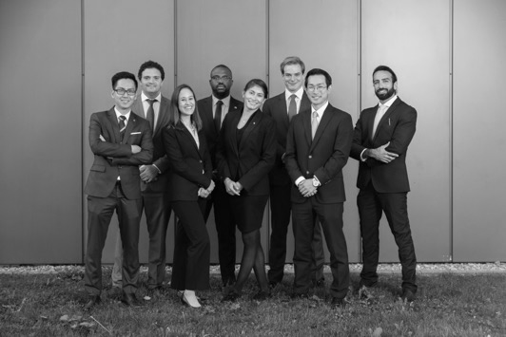


What will you do during residential weeks?
Intense& memorable
Complete industry immersion
Visit properties & engage
with high-end businesses
Network
Build a strong
team dynamic
Get to know the group
& work together
Ice-breaker activities
Meet with guest experts
Course
work
Case studies
Capstone project launch
Notes:
Three main goals:
Bonding the group dynamic: The more they know each other, the better they will be able to work together. Activities include ice breaker activities, meeting with guest experts
Complete industry immersion: allowing you to visit innovative properties and engage with those at the forefront of the hospitality/luxury/service sector. Also some excellent networking opportunities
Course work: Work towards the credit, case studies and in second residential week the capstone project is launched.

Slide 9


Slide 10




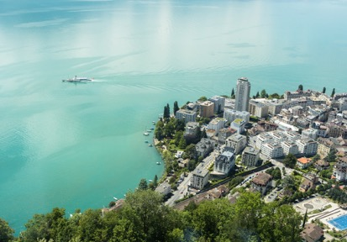
Program highlights
4 leadership-focused
distance learning modules
12 weeks
duration each
2 on-campus residential weeks
one in Switzerland & one in the UK
Face-to-face classes, workshops & field trips
Part-time program
12-months distance learning
14-18 hours
of study per week
Business Research Project
based on a
real-world commercial challenge
Internationally accredited
Master of
Science degree
Worth
32 US credits

Slide 11
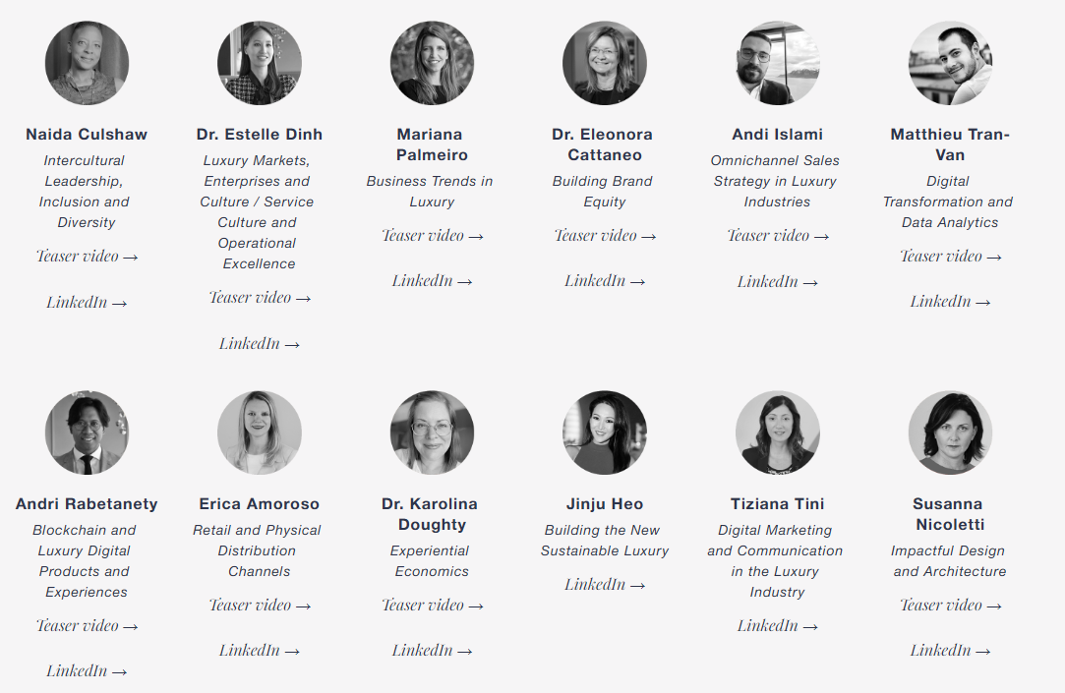
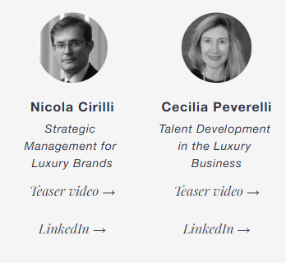
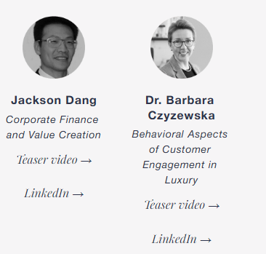
Learn from our experts

Slide 12
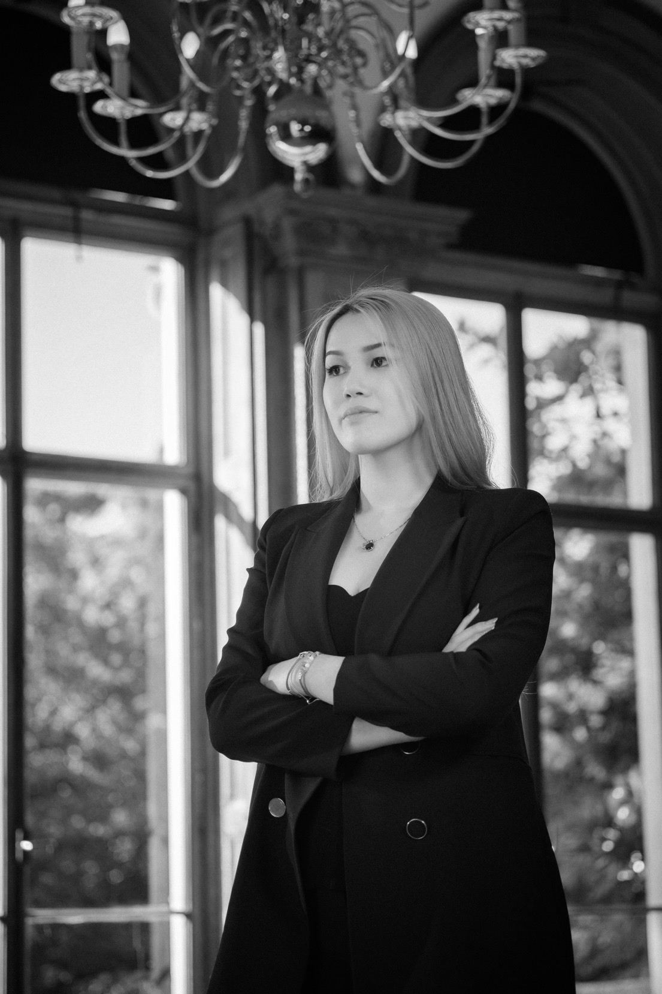
Admission requirements
Minimum age
27 years old
Education
University degree in any discipline
or specialized diploma in luxury or hospitality
Professional experience
At least five years’ experience at managerial level
English language qualifications
Native speaker or two years working in an
English-speaking environment
Or IELTS 6.0 / TOEFL 550 / First Cambridge Exam A / Cambridge Advanced Exam C
English-level will be assessed during the interview

Slide 13



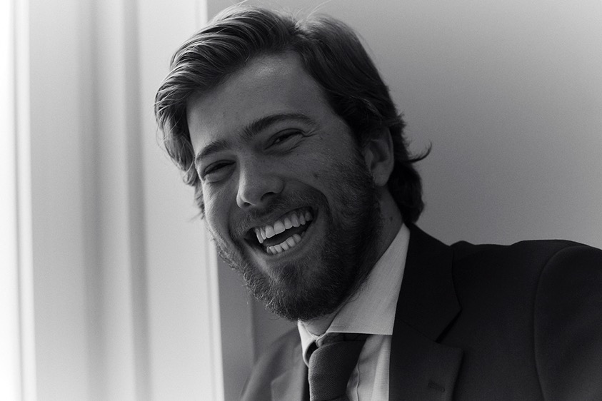
2
Receive your evaluation
If successful, within
1-2 weeks
Admissions process
1
3
Submit
your documents
Application form
CV or Resume
Passport copy
Reference letter
Interview with
the school
Within 15 working days
of receiving your
letter of offer

Slide 14
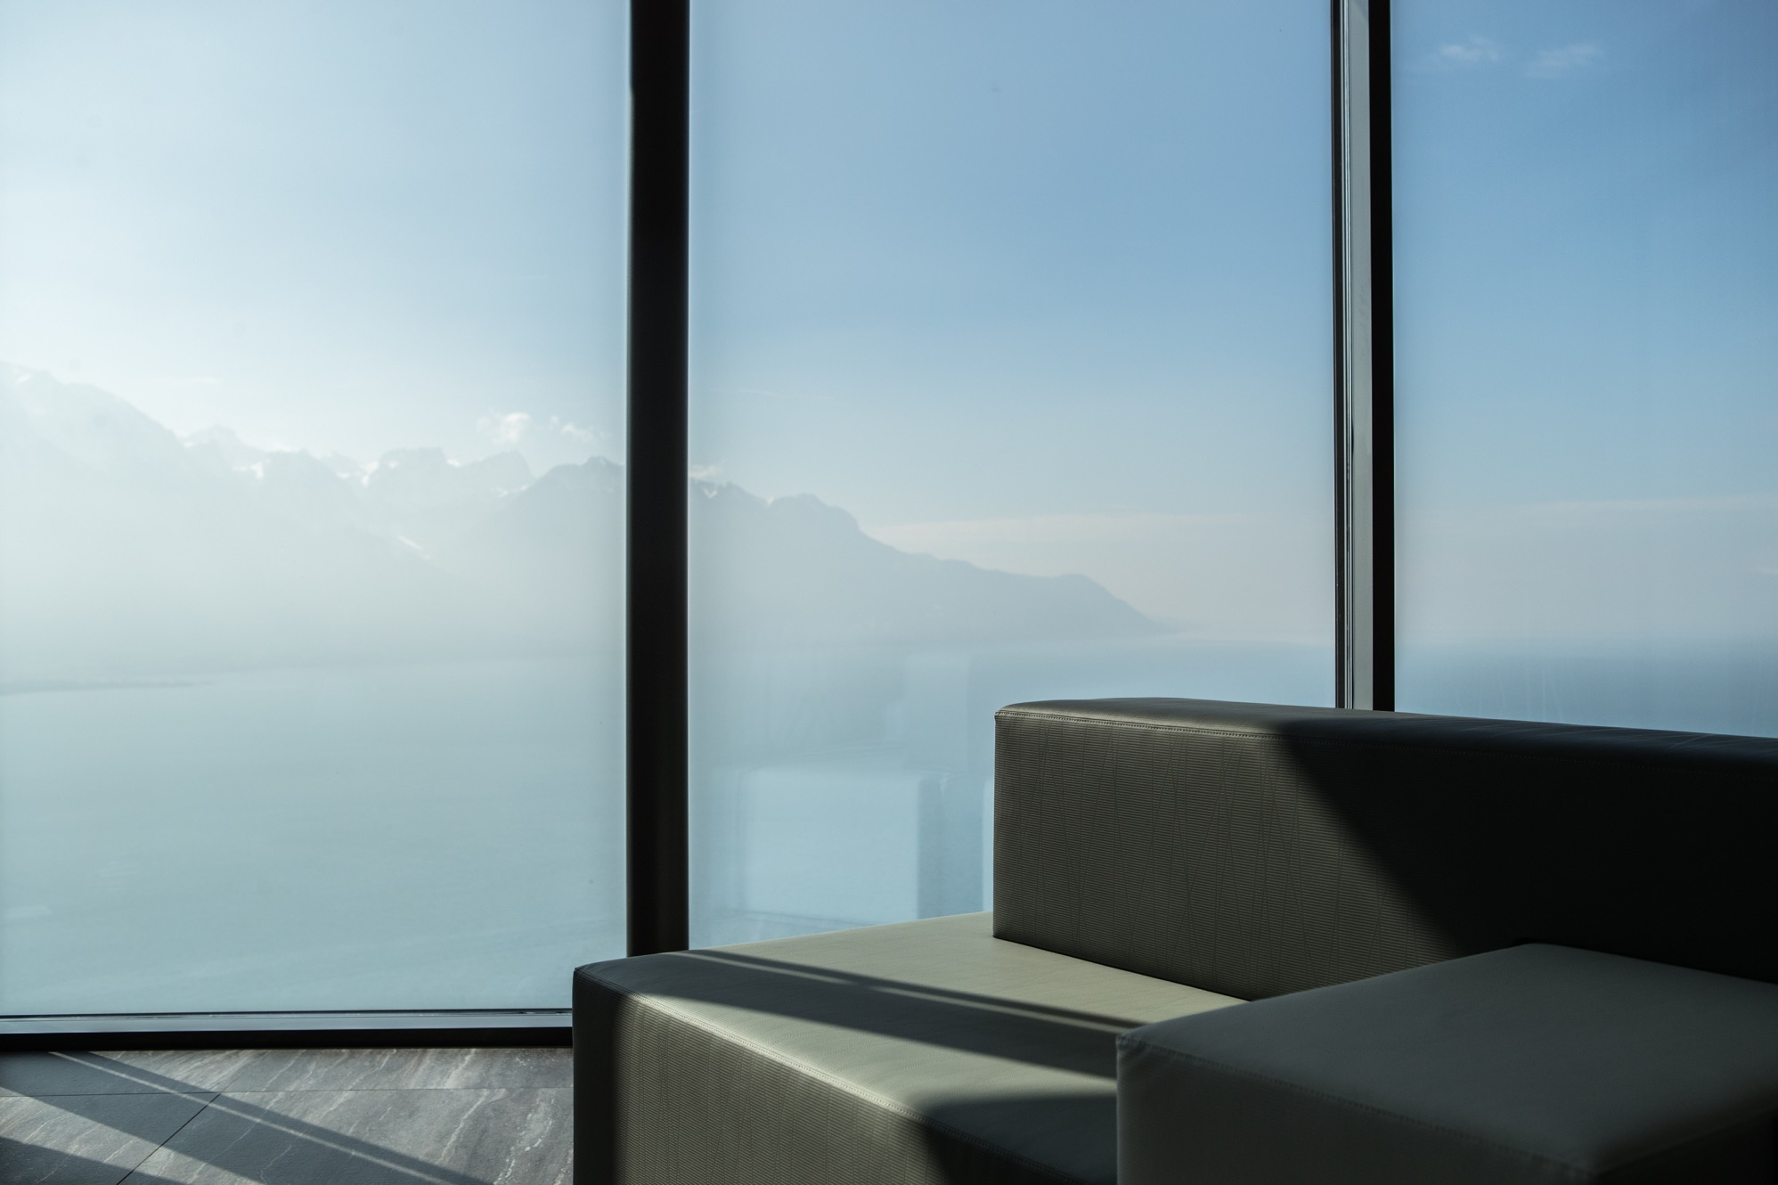

Thank you & any questions?
GLION.EDU

